Slide 1
Forestry in the Czech Republic
Ivan Kuneš
Czech University of Life Science Prague
Faculty of Forestry and Wood Sciences
Department of Silviculture

Slide 2
Czech Republic
Area: 78,866 km²
Population: 10,5 million
Pop. density: 134 / km²
GDP: 296 bn USD
GDP per capita: 27,609 USD

Slide 3
Forestry in the Czech Republic
The forest area in the Czech Republic is nearly 2.6 million ha
Czech forests cover 34% of the land area.
Total growing stock volume: 696 million m3 i.b. (inside bark),
in 1930 it was 300 million m3 i.b.
Total annual increment: ca 17.9 million m3 i.b.
Total annual harvest: 15 million m3 i.b.
Mean growing stock volume: 264 m3/ha i.b..(all age classes and clear-cut tracts)
Minimal age of a planned harvest felling: 80 years

Slide 4
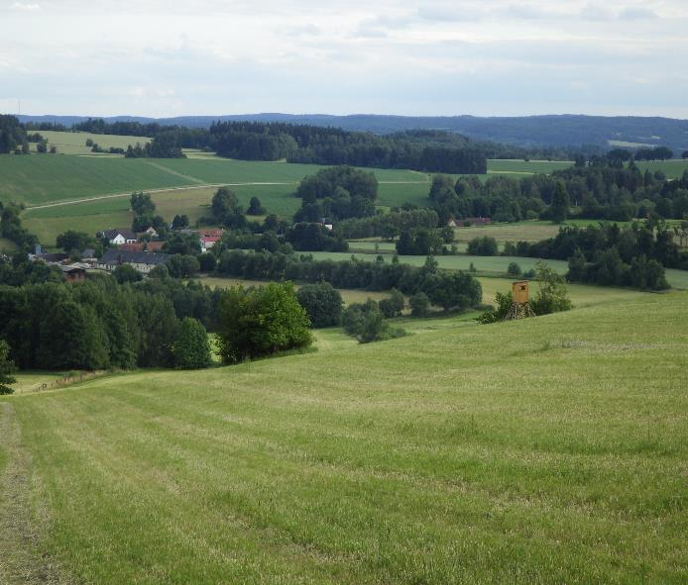
The forest area in the Czech Republic is nearly 2.6 million ha.
Czech forests cover 34% of the land area.
Photo: Kuneš 2016
The mosaic landscape in Czechia consists of agriculture land, forests as well as villages and towns (SE Bohemia).

Slide 7
Proportion of the Czech forestry in the Economic value added (EVA) in basic prices: 0.6%
Czech forestry provides ca 30,000 working posts
(i.e. 0.6% of employable population).
Wood-processing industry provides
cca 77,000 working posts (i.e. 1.7% of employable population).

Slide 8
Recent Czech legislation (Forestry act No. 289/1996) guarantees that the Czech forest should be managed in a sustainable way.
Duty to replant/regenerate forest stand within 2 years (pine weevil) after clear-felling.
Duty to „establish“ the new (reproduced) forest within 7 years after clear felling.
Size limitation of the clear-cut area (planned timber harvesting)

Slide 9
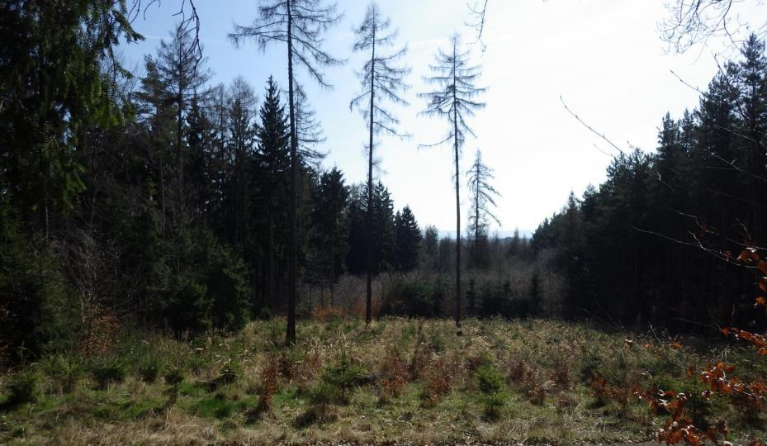
Clearcutting Methods
The maximum size of a planned clear-cut tract is commonly 1 ha in the Czech Republic.
Photo: I. Kuneš 2016

Slide 10
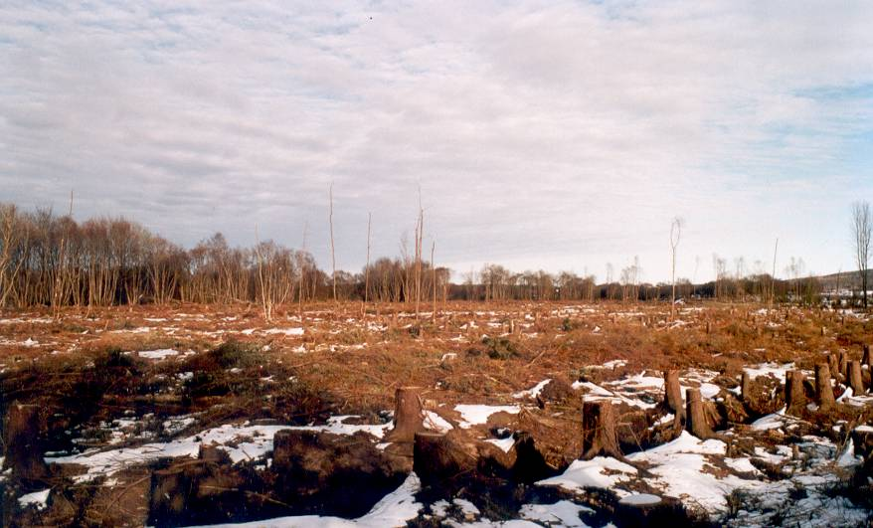
Scotland
Photo: I. Kuneš 2004

Slide 11
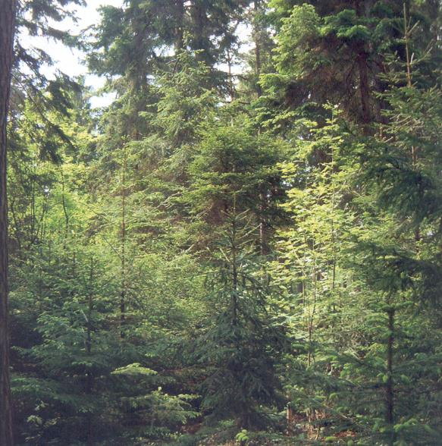
Selection system
Photo: Remeš in Poleno et al., 2007b

Slide 12
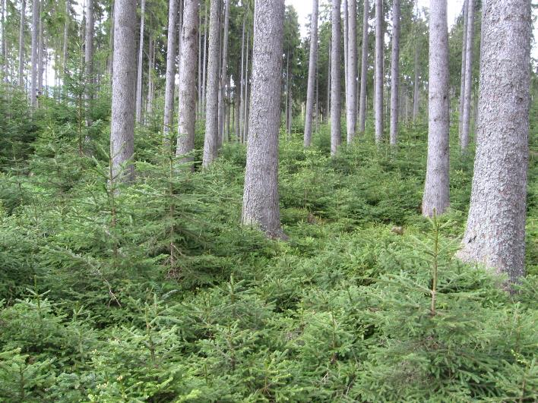
Shelter-wood Methods
Photo: M. Baláš 2006

Slide 14
Principal state bodies managing forest
Forests of the Czech Republic (state enterprise)
Managed forest area: 1.3 mil ha
Army Forests and Estates of the Czech Republic
Managed forest area: 125 000 ha
Ministry of Environment (National Parks): 97 000 ha

Slide 15
Biggest Municipal Owners
Brno (Brünn): 8,186 ha
Písek (Pisek): 6,500 ha
Kašperské hory (Bergreichenstein): 6,084 ha
Bigest Private Owners
Jerome Colloredo-Mansfeld: 17,000 ha
Schwarzenberg family (Jan and Karel): 10,000 ha
Kristina Colloredo-Mansfeld: 9,200 ha

Slide 17
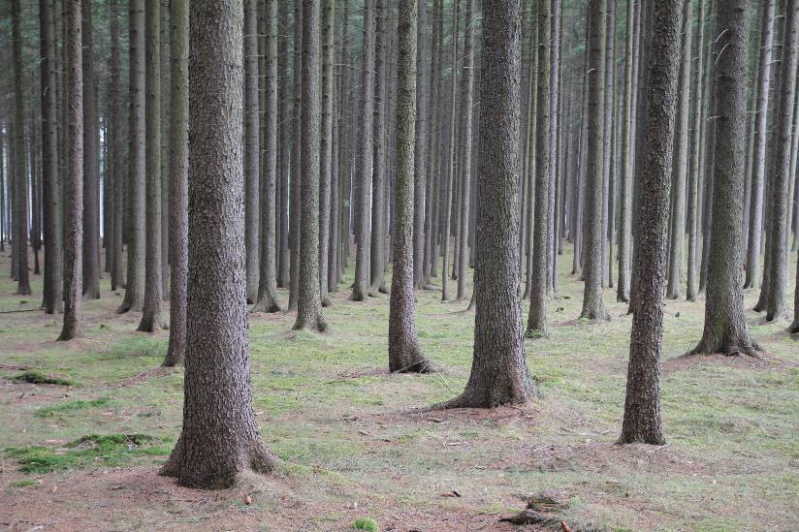
Production forest (pure, even-aged stand)
Photo: M. Baláš 2006

Slide 18
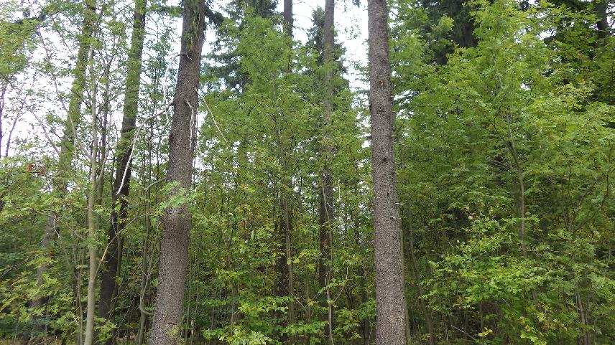
Production forest (mixed, structurally diversified stand)
Photo: I. Kunes 2015

Slide 19
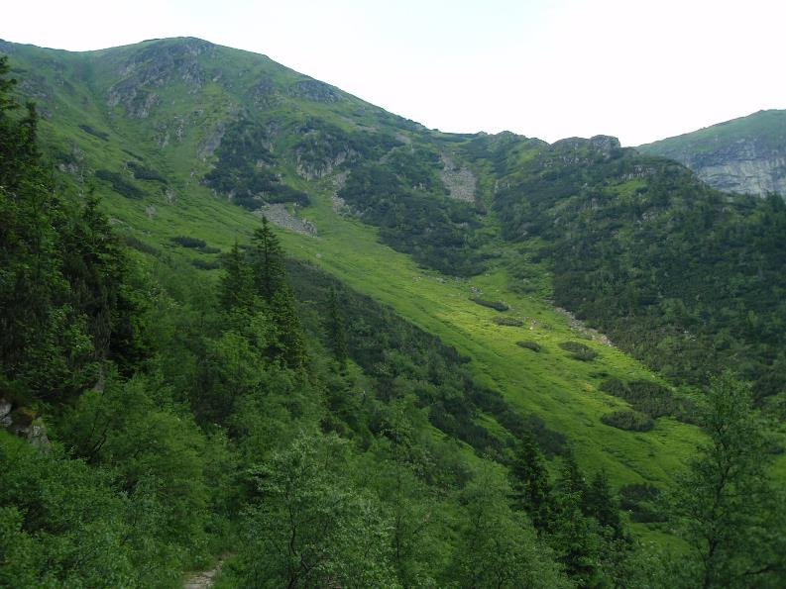
Protection forest – high elevations
Mixture of dwarf pine (Pinus mugo), Norway spruce (Picea abies) and birch (Betula pubescens) close to a forest-limit zone in the Krkonoše (Giant) Mts.
Photo: I. Kunes 2010

Slide 20
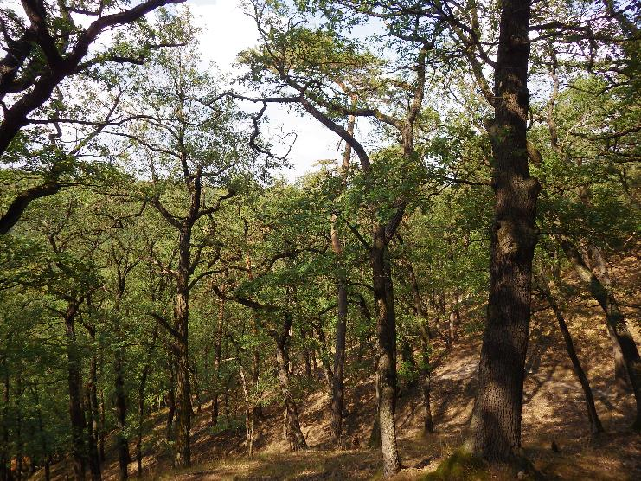
Protection forest – low elevations
Dwarfed oaks (Quercus petraea) on steep slopes with shallow soils (Central Bohemia).
Photo: I. Kunes 2018

Slide 21
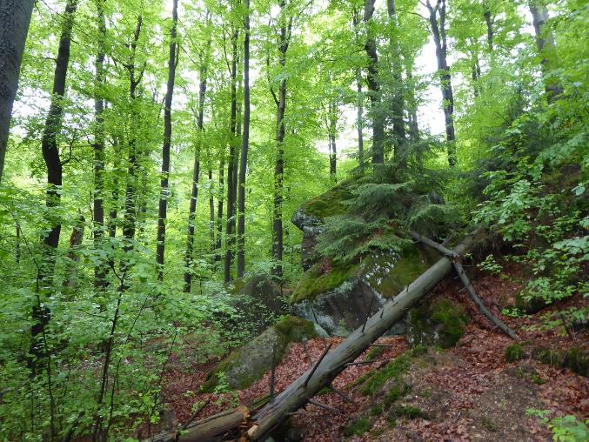
Special purpose forest (nature conservation)
Preserved beech forest complex on the north-facing slopes of the Jizera Mts (Jizerskohorské bučiny) was placed on the UNESCO World Heritage list.
Photo: J. Bursíková 2018

Slide 22
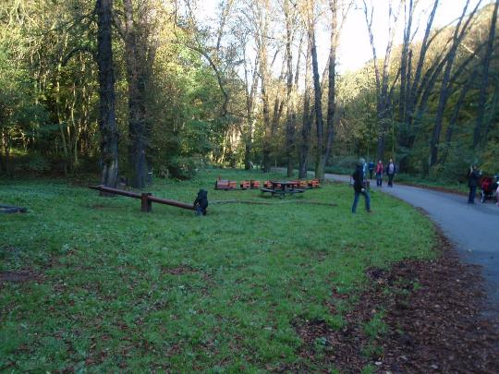
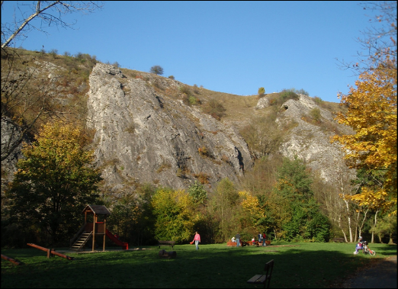
Special purpose forest
Urban Forest (recreation and conservation)
Photo: I. Kuneš 2010
Photo: I. Kuneš 2010

Slide 23
Main Problems of Czech Forestry
Substantially changed species composition
Overstocked hoofed game
Meteorological extremes and climate change
Clash of ideologies and opinions on how the forests should be managed
Acidification

Slide 25
The change in the species composition of the Czech forests is closely linked to historical development.
Human pressure on forests often led to their devastation in the past.
Foresters tried to ensure a sufficient and steady supply of timber for the society.
Instead of forest stands with a native species composition, productive coniferous monocultures (pure even-aged stands) were often planted on the clear-cut tracts.

Slide 26
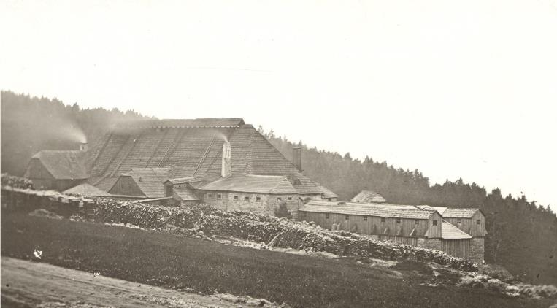
The mountain forests in Czechia were in the past often affected by glassworks that consumed enormous amounts of wood as a fuel or as a source of potassium.
Kristianov – Jizera Mts, Czechia
Figure source: Archives of the Museum of Glass and Jewellery in Jablonec nad Nisou, Czech Republic

Slide 27
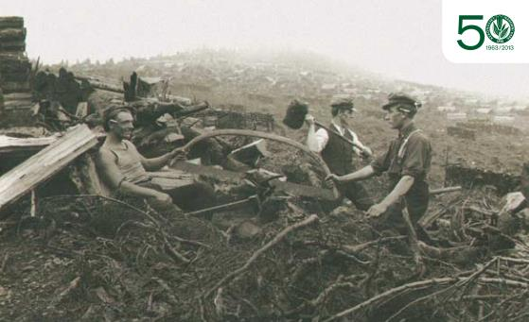
Forest workers felling forest for glassworks in Harrachov (Krkonoše (Giant) Mts) ca by 1900. A common glasswork consumed cca 6,000–10,000 m3 annualy.
Figure source: archives of KRNAP; publication by Šimurda et al. (2012)

Slide 28
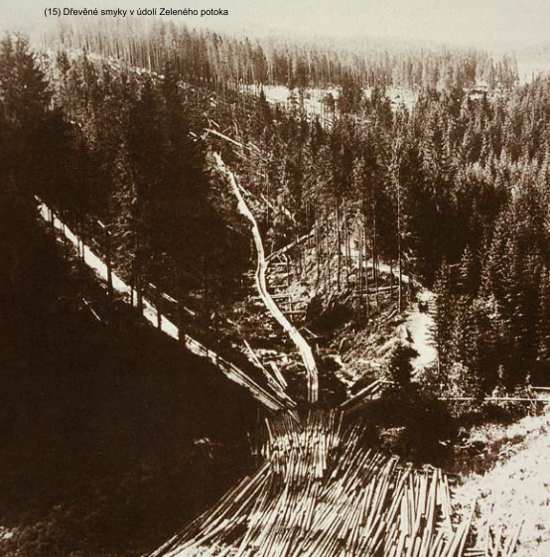
Figure source: archives of KRNAP; publication by Šimurda et al. (2012)

Slide 29
Chosen Four Commercial Tree Species in Czechia

Slide 30
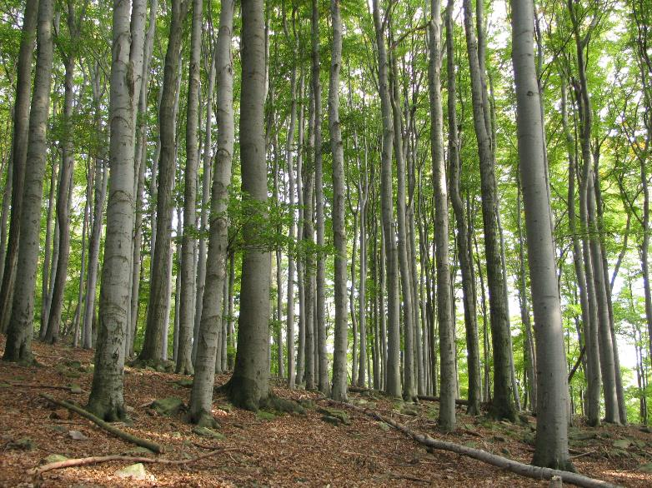
European beech (Fagus sylvatica)
Photo: M. Baláš 2011

Slide 31
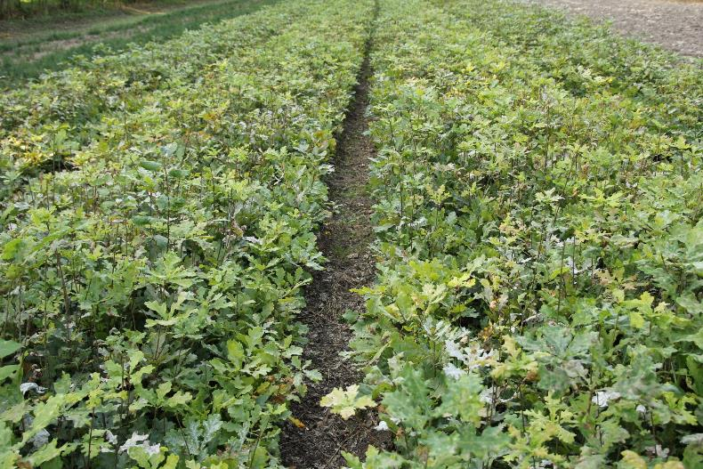
Oak (Quercus Sp.)
Oaks grown in a forest nursery.
Photo: M. Baláš 2011

Slide 32
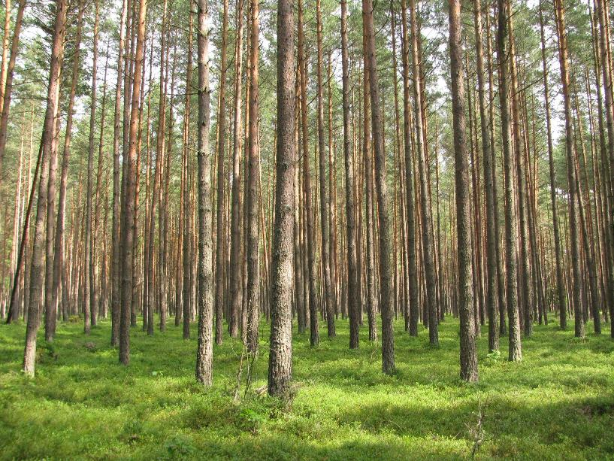
Pine (Pinus sylvestris)
Photo: M. Baláš 2009

Slide 33
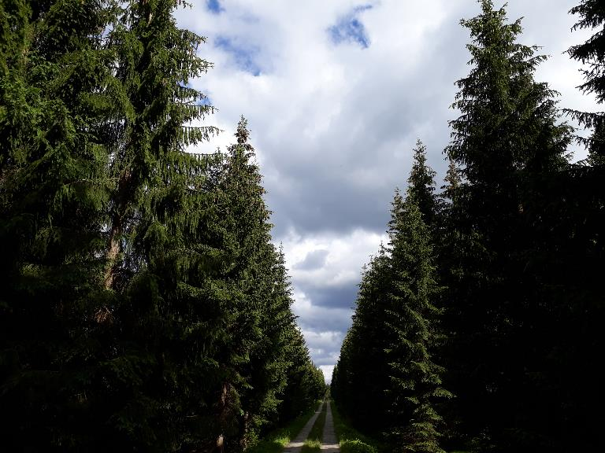
Spruce (Picea abies)
Photo: I. Kuneš 2020

Slide 34
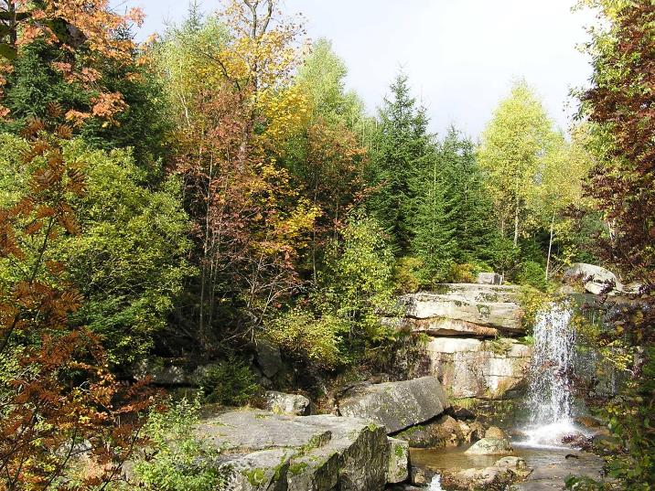
Thank you!
Photo: I. Kuneš 2008

Slide 35
Sources:
Personal archives of the author.
Publicly available data of the resort of Ministry of Agriculture of the Czech Republic (Forest Management Institute https://www.uhul.cz/), Wikipedia (https://en.wikipedia.org/)
POLENO Z., VACEK S., PODRÁZSKÝ V., REMEŠ J., MIKESKA M., KOBLIHA J. and BÍLEK L. (2007). Pěstování lesů II - Teoretická východiska pěstování lesů. Lesnická práce, Kostelec nad Černými lesy. 463 p
ŠIMURDA J. (2012). Příběh lesa – devět století krkonošských hvozdů [The story of the forest - nine centuries of the Krkonoše forests]. Správa krkonošského národního parku, Vrchlabí, Czech Republic. 33 p

