Slide 1
MANAGEMENT
Martin Cabrada
Czech University of Life Sciences Prague

Slide 2
What is the management?
Management is an important element in every organization. It is the element that coordinates current organizational activities and plans for the future.
The management adapts the organization to its environment and shapes the organization to make it more suitable.

Slide 3
The definition of management
“Management is the art of “knowing what you want to do” and then seeing that it is done in the best and cheapest way. ……F. W. Taylor
Management as a process “consisting of planning, organizing, actuating and controlling, performed to determine and accomplish the objective by the use of people and resources.” ……George R. Terry
Notes:
Frederick Winslow Taylor (March 20, 1856 – March 21, 1915) was an American mechanical engineer.
George Robert Terry (1909 – 1979) was an American management author, Professor of Business at Ball State University, and 14th president of the Academy of Management.
actuating – spoštět, uvádět do pohybu
Řízení jako proces „sestávající z plánování, organizování, ovládání a kontroly, prováděný za účelem stanovení a dosažení cíle s využitím lidí a zdrojů“.
In this definition:
Planning means Plan in advance.
Organizing means coordination between human resources and material resources.
Actuating means motivation and giving direction to subordinate.
Controlling means to ensure implementation of plan without deviation.
Thus, this definition tells that management is act of achieving the organization objectives.

Slide 4
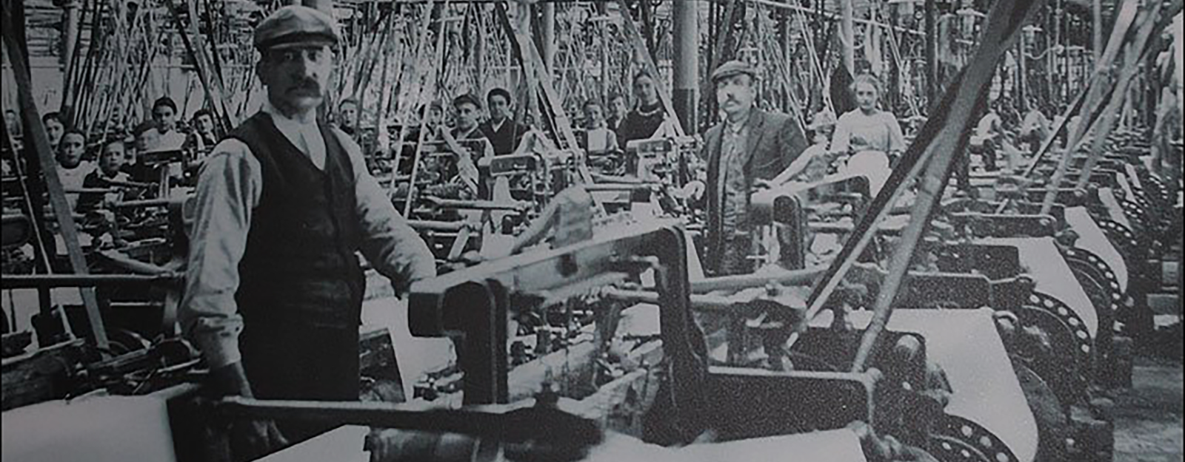
Evolution of Management Thought
The need to study management arose with the industrial revolution in Europe (more specifically, England).
The industrial revolution and the systematic study of management are the result of a remarkable confluence of ideas and events.
Management and organizations are products of their historical and social times and places.
Notes:
the first industrial factories appeared, conveyor belt production was introduced
Steam engine

Slide 5
Scientific Management Theory
Frederick W. Taylor, Henry L. Gantt, and Frank and Lillian Gilbreth devised the body of principles known as scientific management theory.
Notes:
Frederick Winslow Taylor (March 20, 1856 – March 21, 1915) was an American mechanical engineer.
Henry Laurence Gantt (May 20, 1861 – November 23, 1919) was an American mechanical engineer and management consultant who is best known for his work in the development of scientific management.
Frank Bunker Gilbreth (July 7, 1868 – June 14, 1924) and his wife Lillian Moller Gilbreth were industrial engineers and efficiency experts who contributed to the study of industrial engineering in fields such as motion study and human factors.
Lie in the work…

Slide 6
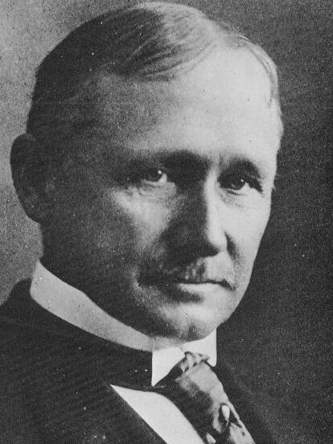
Scientific Management Theory
Taylor based his management system on production-line time studies. Using time study as his base, he broke each job down into its components and designed the quickest and best methods of performing each component.
He also encouraged employers to pay more productive workers at a higher rate than others, using a "scientifically correct" rate that would benefit both company and worker. This system is called Differential Rate System.

Slide 7
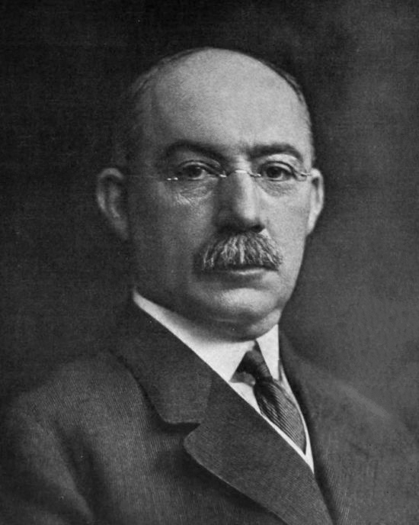
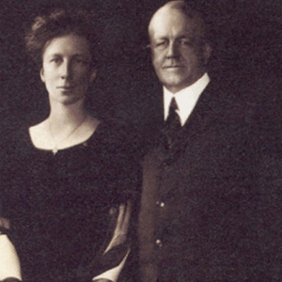
Scientific Management Theory
Gantt originated a charting system for production scheduling.
Every worker's progress was rated publicly and recorded on individual bar charts,--in black on days the worker made the standard, in red when he or she fell below it. Going beyond this.
Frank B. and Lillian M. Gilbreth collaborated on fatigue and motion studies and focused on ways of promoting the individual worker's welfare. To them, the ultimate aim of scientific management was to help workers reach their full potential as human beings.

Slide 8
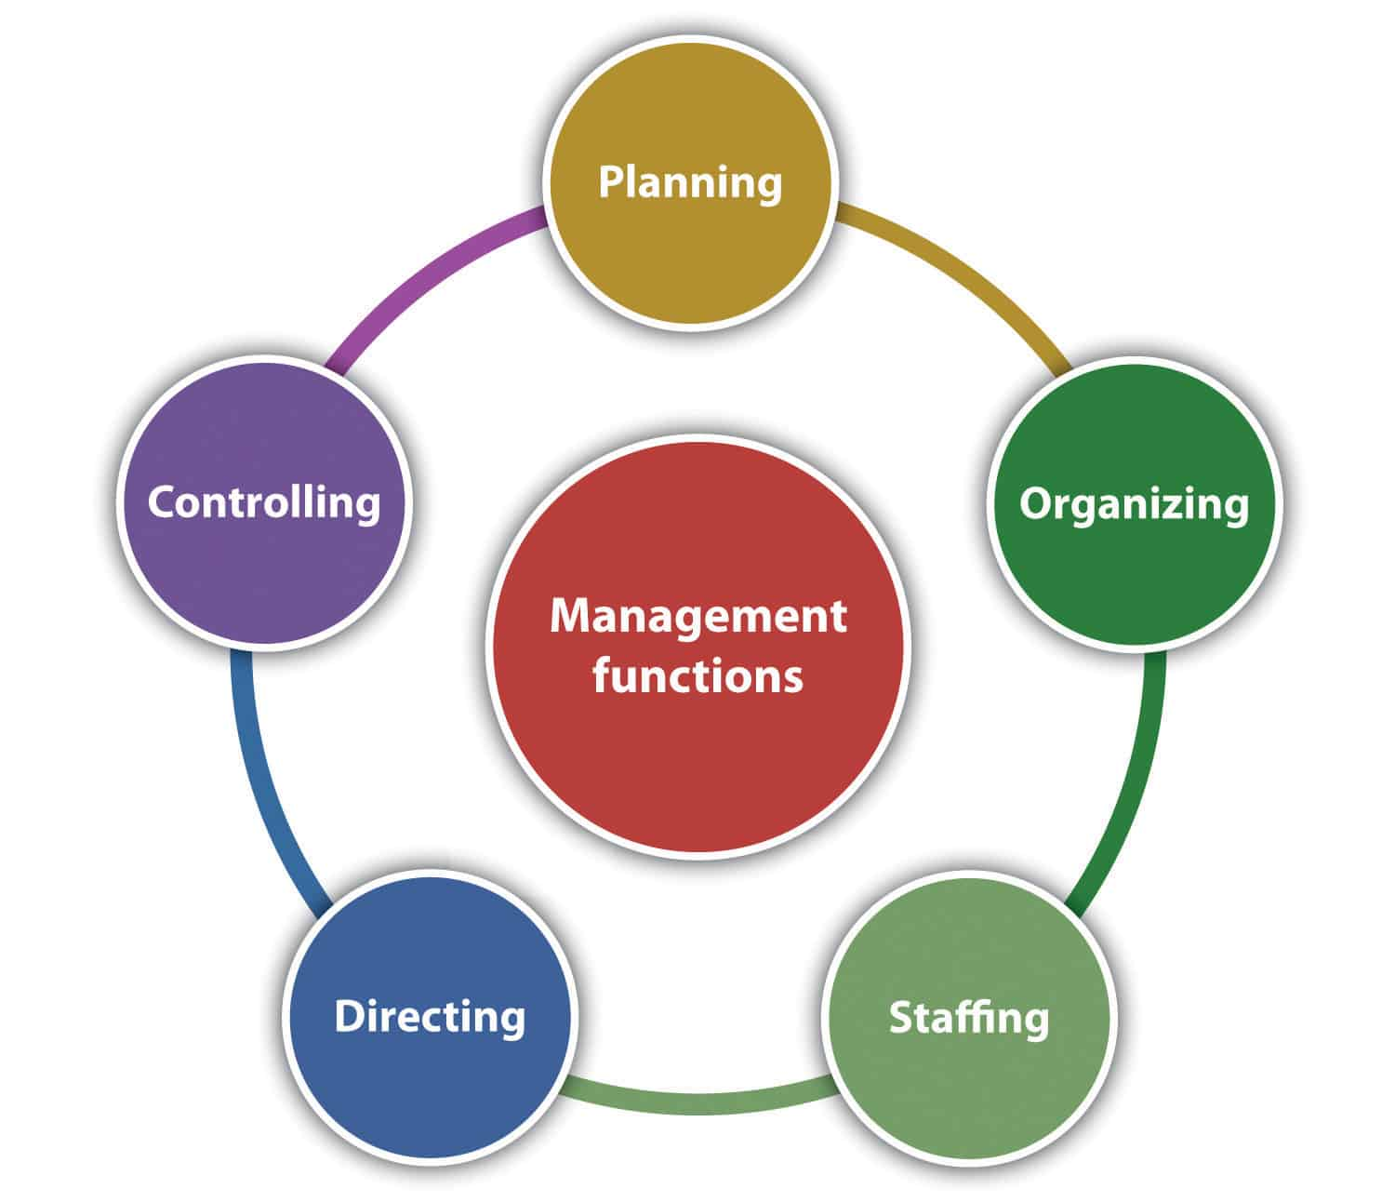
Management functions
Planning, Organizing, Leading & Controlling (Newman & Summer)
Planning, Organizing, Commanding, Coordinating and Controlling (Henri Fayol)
‘POSDCORB’: Planning, Organizing, Staffing, Directing, Coordinating, Reporting & Budgeting (Luther Gulick)
Decision Making, Organizing, Staffing, Planning, Controlling, Communicating & Directing (Warren Haynes & Joseph Massie)
Planning, Organizing, Staffing, Directing & Controlling (Koontz, O’Donnell)
Notes:
Harold Koontz and Cyril O'Donnell, in their book, Principles of Management: An Analysis of Managerial Functions. clearly described the principles to be used in performing various functions of management..

Slide 9
Functions of Management - Planning
It is a process of deciding the business objectives and charting out the plan / method for achieving the same.
This includes determination of what is to be done, how, and where it is to be done, who will do it and how results are to be evaluated.
This function expected to be carried out throughout the organization. It should be performed by the manager at all levels.
Notes:
When you think of planning in a management role, think about it as the process of choosing appropriate goals and actions to pursue and then determining what strategies to use, what actions to take, and deciding what resources are needed to achieve the goals.

Slide 10
4 Types of Plan
Strategic Planning
A high-level overview
Tactical Planning
Tactics used to achieve the strategy
Includes specific goals, budget, resources
Operational Planning
Plan B when something unexpected happens or when something needs to be changed
Long term plan (typically 5 or 10 years)
Forward looking
Short term plan (typically 1 year or less)
Plan for day to day running
Contingency Planning
Controlled via daily/weekly/monthly reports
Notes:
Strategic planning is the long-term planning for the achievement and survival of the organization. It is a mission and answers the why of the organization. It can even be as long as 10-year long planning. It comes from the highest level of the company and represents the vision of the organization.
For example: The company wants to enter a new market. The strategic plan can be: To enter German market in next 5 years, take over (20 %) significant share of the market and become a respected company providing high quality services.
Tactical planning helps you understand and break down your strategy in chunks to achieve it sooner. Tactics are short-term flexible and less risky actions which a company takes to move forward in a short time. This type of planning is more associated with mid-level departments and is action-oriented.
For example: Find suitable premises for the company headquarters in Munic, Germany within 2 years with the budget 1 mio EUR.
Operational planning: It involves day to day planning of any organization. Operational planning helps you to drive the workforce and to overcome the challenges faced by the workers on daily business. Operational planning is the guidelines and involves what, when and who, outlines policies, rules, and regulations, management of staff and their training, etc. It is used to implement strategic planning in short and doable steps. It helps you to identify and mitigate the risks and dangers a company faces frequently.
For example:
Check at least 3 suitable locations for a new headquarters every day, write down their advantages and disadvantages.

Slide 11
Discussion 1 - Planning
Do you have a strategic plan at your university? Do you know it?

Slide 12
Functions of Management – Organizing
Organizing is the process of assembling the people, organizing resources, and distributing the planned work necessary to carry out the manager's plan.
Organizing is driven by goals identified during the managerial planning process.
It includes developing an organizational structure that allows for the efficient execution of tasks to complete objectives and obtain goals.
Notes:
This process of establishing worker relationships allows workers to work together to achieve their organizational goals.
The organizing refers to “the structured which results from identifying and grouping the work, defining and delegating responsibility and authority and establishing relationships.”
To organize a business is to provide it with everything useful to its functioning i.e. personnel, raw materials, machineries, capital etc.
Once objectives are established, manager has to develop plan to achieve them with help of human resources as well as material resources.

Slide 13
Management System
structure
behaviour
output
Structure of processes
Structure of departments/units
Organizational structure

Slide 14
Functions of Management – Organizing: 1st step

Slide 15
Functions of Management – Organizing: 2nd step

Slide 16
Functions of Management – Organizing: 3rd step

Slide 17
Functions of Management – Organizing: 4th step

Slide 18
Functions of Management – Key elements
Span of control
Departmentalization
Work specialization
Chain of command
Department
Centralization & decentralization
2 level of management
Formalization
Department 01
Department 02
Department 03
1 level of management
0 level of management
Notes:
The key elements in organizational design are work specialization, chain of command, span of control, departmentalization, centralization-decentralization, and formalization.
The chain of command: is the unbroken line of authority that extends from the top of the organization (e.g., the CEO or the President) to the lowest groups and clarifies who reports to whom. The chain of command and its companion concepts—authority, responsibility, and unity of command—were viewed as important ways of maintaining control in organizations. The contemporary view is that they are less relevant in today’s organizations.
Tha span of control: Span of control deals with the number of subordinates a manager can effectively direct. The wider an organization can make its managers’ spans of control the more efficient it will be. Wider spans of control save money. The traditional view of span of control was that managers should directly supervise no more than five to six individuals. The contemporary view is that the span of control depends on the skills and abilities of the manager and the employees and on the characteristics of the situation.
Traditionally, work specialization was viewed as a way to divide work activities into separate job tasks. Today’s view is that it is an important organizing mechanism, but it can lead to problems.
Once jobs are divided up through work specialization, those jobs need to be combined together to coordinate common tasks. Departmentalization is the basis by which jobs are grouped together. Jobs can be grouped in many ways:
Function. This is among the most popular way to group activities. Corporations might have a supply chain function, a finance function, a human resources function. All the worker specializations for those areas are grouped together, and people with common skills work in common units.
Product. A large manufacturing company might group its common tasks together by product. A paper products manufacturer might have a department for office paper, and other department for bathroom tissues, and yet another for cartons. The major advantage of organizing common tasks this way is to increase employee accountability for the success of those products.
Geography. If an organization’s customers are scattered over a geographic region, an organization might choose to group common tasks geographically. A company that has a South, Midwest, and Eastern sales function is organizing around territory, or geography.
Process. A manufacturing plant might choose to organize common tasks around process. A tubing plant might organize departments around casting, pressing, finishing, packaging, etc. Each department specializes in one particular part of the manufacturing process. The same kind of departmentalization is true of the Department of Motor Vehicles, where you proceed from one area to another to renew your license plates or your driver’s license.
Customer. A business might choose to combine tasks around the type of customer it serves. For instance, a service like Dropbox.com has free file sharing and cloud storage for its individual users, but there is also a department of Dropbox that services business clients.
Centralization refers to the degree to which decision making is concentrated at a single point in the organization. In a decentralized organization, employees are empowered to make decisions, so action can be taken quickly to solve problems, and employee input is considered. The more lower-level employees have the power to make decisions, the more decentralized an organization is. In a centralized organization, upper management makes all decisions and lower management is there to carry those decisions out.
Formalization refers to the degree to which jobs within the organization are standardized. An employee in a highly formalized job has little input as to how that job is done, when it’s done or how it should be done. A worker on the assembly line is probably in a highly formalized job, where he doesn’t have much say in how he does his job. An accounts payable associate also doesn’t have a lot of say in how those many invoices are processed, but her job is probably a little less formalized than the assembly line worker. A sales associate, out calling on customers, may have very little formalization in his job.

Slide 19
Level of organization
rules
rules
rules
manager
manager
employee
manager
employee
employee
Mechanistic
Organic

Slide 20
Level of organization
Notes:
Take a look at the diagram below. As you'll probably be able to tell, the mechanistic structure represents the traditional, top-down approach to organizational structure, whereas the organic structure represents a more collaborative, flexible approach.
Mechanistic Structure
Mechanistic structures, also called bureaucratic structures, are known for having narrow spans of control, as well as high centralization, specialization, and formalization. They're also quite rigid in what specific departments are designed and permitted to do for the company.
This organizational structure is much more formal than organic structure, using specific standards and practices to govern every decision the business makes. And while this model does hold staff more accountable for their work, it can become a hindrance to the creativity and agility the organization needs to keep up with random changes in its market.
As daunting and inflexible as mechanistic structure sounds, the chain of command, whether long or short, is always clear under this model. As a company grows, it needs to make sure everyone (and every team) knows what's expected of them. Teams collaborating with other teams as needed might help get a business off the ground in its early stages, but sustaining that growth — with more people and projects to keep track of — will eventually require some policymaking. In other words, keep mechanistic structure in your back pocket ... you never know when you'll need it.
Organic Structure
Organic structures (also known as "flat" structures) are known for their wide spans of control, decentralization, low specialization, and loose departmentalization. What's that all mean? This model might have multiple teams answering to one person and taking on projects based on their importance and what the team is capable of — rather than what the team is designed to do.
As you can probably tell, this organizational structure is much less formal than mechanistic, and takes a bit of an ad-hoc approach to business needs. This can sometimes make the chain of command, whether long or short, difficult to decipher. And as a result, leaders might give certain projects the green light more quickly but cause confusion in a project's division of labor.
Nonetheless, the flexibility that an organic structure allows for can be extremely helpful to a business that's navigating a fast-moving industry, or simply trying to stabilize itself after a rough quarter. It also empowers employees to try new things and develop as professionals, making the organization's workforce more powerful in the long run. Bottom line? Startups are often perfect for organic structure, since they're simply trying to gain brand recognition and get their wheels off the ground.

Slide 21
The Types and Roles of Managers within the Organization
Lower Level (first line): foremen & white collar supervisor
Middle management: sales managers, personnel managers, other departmental heads
Top management: company presidents, executives, vice presidents
Notes:
Organizational structure is important in driving the business forward and every organization has a structure. No matter the organizationally specific title, organizations contain front-line, middle, and top managers. Above the top management team are a CEO and a board of director levels. To see this structure even more clearly, visualize a pyramid model. The more you move toward the top of the pyramid, the fewer managers you have. All of these management roles have specific tasks and duties. According to Jones and George, “A managerial role is the set of specific tasks that a manager is expected to perform because of the position he or she holds in an organization.”

Slide 22
The Types and Roles of Managers within the Organization
Top Management
Conceptual Skills
Middle Management
Human Relation Skills
Lower Level
Technical Skills

Slide 23
Outsourcing
Outsourcing is a business practice in which services or job functions are hired out to a third party on a contract or ongoing basis.
Companies may choose to outsource services
onshore (within their own country),
nearshore (to a neighboring country or one in the same time zone), or
offshore (to a more distant country).

Slide 24
What activities can be easily outsourced
Accounting and Finance
Marketing
Customer Support
Sales
IT and Helpdesk
Human Resources
Shipping and Logistics
Research and Development
Admin
Creatives

Slide 25
Pros and cons
OUTSOURCING BENEFITS | OUTSOURCING RISKS
lower costs (due to economies of scale or lower labor rates) increased efficiency variable capacity increased focus on strategy/core competencies access to skills or resources increased flexibility to meet changing business and commercial conditions accelerated time to market lower ongoing investment in internal infrastructure access to innovation, intellectual property, and thought leadership possible cash influx resulting from transfer of assets to the new provider | slower turnaround time lack of business or domain knowledge language and cultural barriers time zone differences lack of control

Slide 26
Discussion 2 - Organizing
Let‘s discuss the organization structure at your university, the span of control, level of formalization, outsourcing etc.

Slide 27
Functions of Management – Leading / Directing
This function involves
articulating a vision,
energizing employees,
inspiring and motivating people using vision, influence, persuasion,
and effective communication skills.
Notes:
Directing involves communication, leadership and motivation.
Communication is the process of passing the information and understanding it from one person to other person.
Leadership is the function whereby the person or manager guides and influences the work of his subordinates.
Motivation is to motivate the employee to give their best to the organization.

Slide 28
Notes:
The difference between a boss vs leader has nothing to do with your job position, at a glance, the same. They’re both individuals who lead another group of people. The terms boss and the leader are often used interchangeably but both boss and leader have different connotations. Even more crucially, when you see a boss vs. a leader in the practice, you can see the difference.
The Boss is a strong personality who focuses on business outcomes rather than relationships. Whereas, Leaders take measured and make positive changes in relationships, business practices, and communications.
Understand the concept of boss vs. leader in this article and lead your fellow mates regardless of your official title.
Who Is Boss?
A boss is an individual who is in charge of the organisation. He is someone who takes control over employees, uses orders to assign tasks and duties to them.
In a company there is no term called ‘boss’, but the word indicates a person who is the owner of the organization.
Who is a Leader?
A leader is an individual who has the ability to influence and leads others by example. He is someone who holds a dominant position with a vision and stays committed to his goal. The qualities of a good leader are:
Foresightedness
Great communication skills
Art of influencing and motivating others
Stimulates work
Clear goals
Appreciate others
Sets examples
Takes responsibilities
Does right things

Slide 29
Motivation
Motivation is an internal or external factor or a set of factors leading to energisation of the organism. Motivation control our behaviour and actions aimed at achievement of a certain objective.
Motivation expresses a sum of – joy, curiosity, positive feelings, positive expectations supporting of attenuating the individual to act or to avoid acting.
Motives are personal causes of certain actions – they are stimuli, psychological causes of actions and reactions, human conduct and activities focused on certain need satisfaction.

Slide 30
Classfication of Motivation
Internal motivation – a result of human needs and interests (the need for knowledge, self-fulfillment, cultural needs)
External motivation – determined by external stimuli and their action (the threat of punishment, the possibility of reward)

Slide 31
Another Classification of Motivation
negative: sanctions
motivation
positive: rewards

Slide 32
Monetary elements of motivation
wage (including bonuses, surcharges …)
profit share
corporate social benefits
extraordinary corporate rewards (for outstanding performance, for improvement proposals, …)

Slide 33
Non-Monetary elements of motivation
Qualification improvement
Promotion, self-fulfillment
Inclusion in work team
Management style and culture (autocratic, democratic, liberal, uncontrolled)
Working hours and breaks
Job description
Technological equipment and work environment
Corporate social programme

Slide 34
Functions of Management - Staffing
Recruiting and selecting employees for positions within the company (within teams and departments).
Staffing is an important managerial function
Staffing is a pervasive activity
Staffing is a continuous aktivity
The basis of staffing function is efficient managment of personnels
Staffing helps in placing right men at the right job
Staffing is perfomed by all managers
Notes:
Staffing is an important managerial function- Staffing function is the most important mangerial act along with planning, organizing, directing and controlling. The operations of these four functions depend upon the manpower which is available through staffing function.
Staffing is a pervasive activity- (všeprostupující) As staffing function is carried out by all mangers and in all types of concerns where business activities are carried out.
Staffing is a continuous activity- This is because staffing function continues throughout the life of an organization due to the transfers and promotions that take place.
The basis of staffing function is efficient management of personnels- Human resources can be efficiently managed by a system or proper procedure, that is, recruitment, selection, placement, training and development, providing remuneration, etc.
Staffing helps in placing right men at the right job. It can be done effectively through proper recruitment procedures and then finally selecting the most suitable candidate as per the job requirements.
Staffing is performed by all managers depending upon the nature of business, size of the company, qualifications and skills of managers,etc. In small companies, the top management generally performs this function. In medium and small scale enterprise, it is performed especially by the personnel department of that concern.

Slide 35
Functions of Management - Controlling
Evaluate how well you are achieving your goals, improving performance, taking actions. Put processes in place to help you establish standards, so you can measure, compare, and make decisions.

Slide 36
Functions of Management - Controlling
The controlling involves:
Establishing standards of performance.
Measuring current performance and comparing it against the established standard.
Taking corrective action that does not meet the standard.
Control compels the events to confirm to plans.

Slide 37
MARKETING

Slide 38
What is the marketing?
No profit grows where is no pleasure taken.
William Shakespeare
Marketing means managing markets to bring about exchanges for the purpose of satisfying human needs and wants.
Marketing is a process by which individuals and groups obtain what they need and want by creating and exchanging products and value with others.
Notes:
What does the term marketing mean? Marketing must be understood not in the old sense of making a sale - 'selling' - but in the new sense of satisfying customer needs. Many people think of marketing only as selling and advertising. And no wonder, for every day we are bombarded with television commercials, newspaper ads, direct mail and sales calls. Someone is always trying to sell us something. It seems that we cannot escape death, taxes or selling! Therefore, you may be surprised to learn that selling and advertising are only the tip of the marketing iceberg. Although they are important, they are only two of many marketing functions, and often not the most important ones. If die marketer does a good job of identifying customer needs, develops products that provide superior value, distributes and promotes them effectively, these goods will sell very easily.

Slide 39
What is the marketing?
Selling? Promotion / advertising?
Marketing vs selling
marketing
selling
Marketing vs promotion
promotion
Notes:
What does the term marketing mean? Marketing must be understood not in the old sense of making a sale - 'selling' - but in the new sense of satisfying customer needs. Many people think of marketing only as selling and advertising. And no wonder, for every day we are bombarded with television commercials, newspaper ads, direct mail and sales calls. Someone is always trying to sell us something. It seems that we cannot escape death, taxes or selling! Therefore, you may be surprised to learn that selling and advertising are only the tip of the marketing iceberg. Although they are important, they are only two of many marketing functions, and often not the most important ones. If die marketer does a good job of identifying customer needs, develops products that provide superior value, distributes and promotes them effectively, these goods will sell very easily.

Slide 40
Some definitions…
Marketing is an organizational function and a set of processes for creating, communicating and delivering value to customers and for managing customer relationships in ways that benefit the organization and its stakeholders. American Marketing Association 2004
Marketing is the management process that identifies, anticipates and satisfies customer requirements profitably. The Chartered Institute of Marketing

Slide 41
Some definitions…
Marketing is the human activity directed at satisfying human needs and wants through an exchange process’ Kotler 1980
‘Marketing is a social and managerial process by which individuals and groups obtain what they want and need through creating, offering and exchanging products of value with others’ Kotler 1991
“Marketing is the process of planning and executing the conception, pricing, promotion and distribution of ideas, goods and services to create exchanges that satisfy individual and organizational objectives” American Marketing Association

Slide 42
The Marketing Mix
= set of marketing tools that the firm uses to pursue its marketing objectives in the target market
4Ps concept proposed by Philip Kotler & E. Jerome McCarthy. 4Ps means:
Product
Price
Place
Promotion

Slide 43
Category | Definition/Explanation/Concept | Typical Marketing Decisions
Product | A product refers to an item that satisfies the consumer's needs or wants. Products may be tangible (goods) or intangible (services, ideas or experiences). | Product design – features, quality Product assortment – product range, product mix, product lines Branding Packaging and labeling Services (complimentary service, after-sales service, service level) Guarantees and warranties Returns Managing products through the life-cycle
Notes:
Product refers to what the business offers for sale and may include products or services. Product decisions include the "quality, features, benefits, style, design, branding, packaging, services, warranties, guarantees, life cycles, investments and returns".

Slide 44
Category | Definition/Explanation/Concept | Typical Marketing Decisions
Price | Price refers to the amount a customer pays for a product. Price may also be a consumer's expectation for getting a certain product (e.g. time or effort). Price is the only variable that has implications for revenue. Price is the only part of the marketing mix that talks about the value for the firm. Price also includes considerations of customer perceived value. | Price strategy Price tactics Price-setting Allowances – e.g. rebates for distributors Discounts – for customers Payment terms – credit, payment methods
Notes:
Price refers to decisions surrounding "list pricing, discount pricing, special offer pricing, credit payment or credit terms". Price refers to the total cost to customer to acquire the product, and may involve both monetary and psychological costs such as the time and effort spent in acquisition. Distribution channels are taken into consideration that includes retailer, wholesaler, Business to Business or Business to Customer .

Slide 45
Category | Definition/Explanation/Concept | Typical Marketing Decisions
Place | Refers to providing customer access Considers providing convenience for consumer. | Strategies such as intensive distribution, selective distribution, exclusive distribution Franchising Market coverage Channel member selection and channel member relationships Assortment Location decisions Inventory Transport, warehousing and logistics
Notes:
Place is defined as the "direct or indirect channels to market, geographical distribution, territorial coverage, retail outlet, market location, catalogues, inventory, logistics, and order fulfillment". Place refers either to the physical location where a business carries out business or the distribution channels used to reach markets. Place may refer to a retail outlet, but increasingly refers to virtual stores such as "a mail order catalogue, a telephone call centre or a website. Example, firms that produce luxury goods like Louis Vuitton employ an intensive placement strategy by making their products available at only a few exclusive retailers. In contrast, lower priced consumer goods like toothpaste and shampoo, typically employ an extensive placement strategy by making their products available to as many different retailers as possible."

Slide 46
Category | Definition/Explanation/Concept | Typical Marketing Decisions
Promotion | Promotion refers to marketing communications May comprise elements such as: advertising, PR, direct marketing and sales promotion. | Promotional mix - appropriate balance of advertising, PR, direct marketing and sales promotion Message strategy - what is to be communicated Channel/ media strategy - how to reach the target audience Message Frequency - how often to communicate
Notes:
Promotion refers to "the marketing communication used to make the offer known to potential customers and persuade them to investigate it further". Promotion elements include "advertising, public relationns, direct selling and sales promotions.„
Slogan: Sell a product or promote a brand.
Tagline: Inspire people to connect a brand with a specific idea.

Slide 47
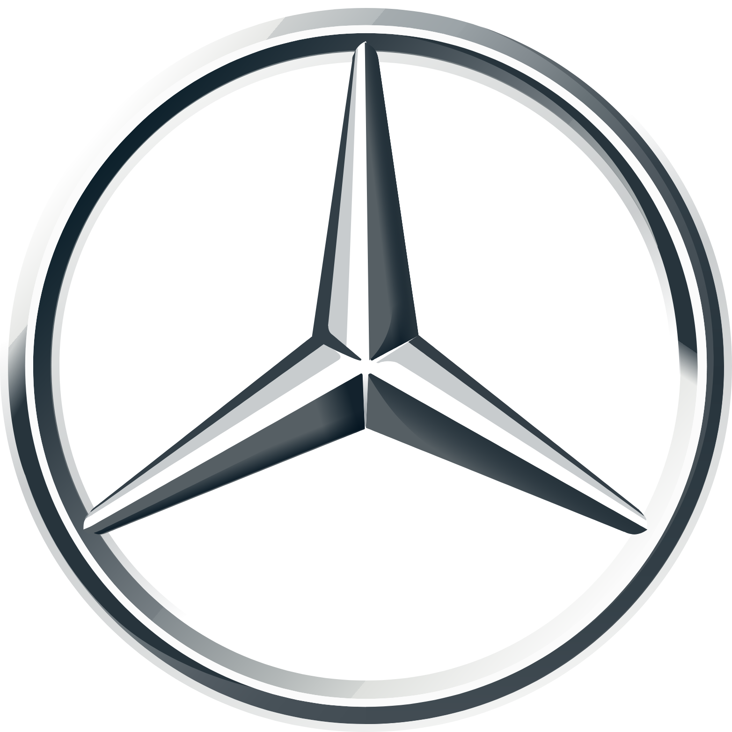
Nike
Shell
Mercedes-Benz
Marriott International
Notes:
Promotion refers to "the marketing communication used to make the offer known to potential customers and persuade them to investigate it further". Promotion elements include "advertising, public relations, direct selling and sales promotions."

Slide 48
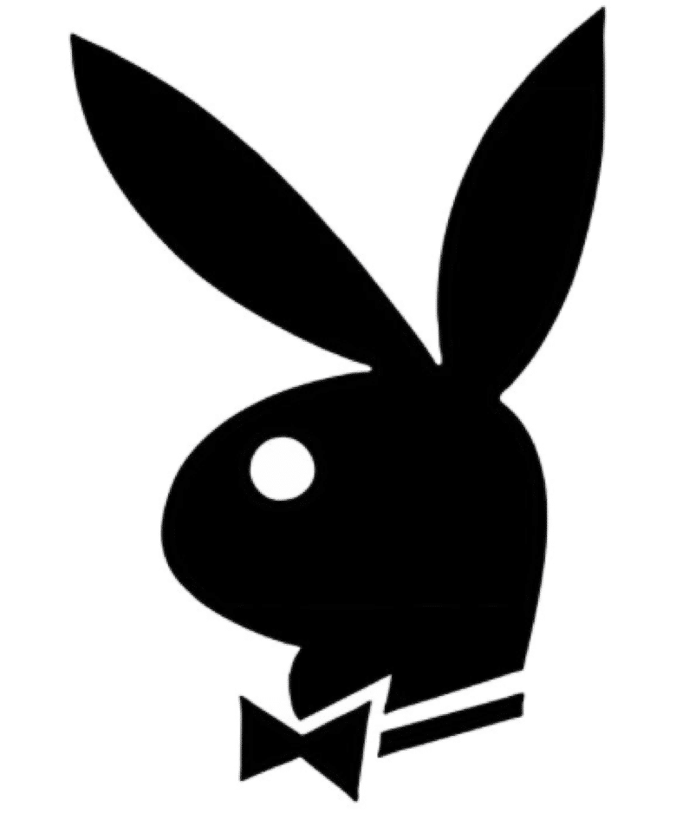
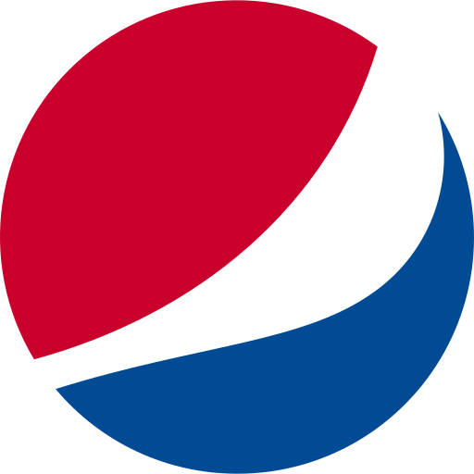
Playboy
Beerlao
Microsoft Windows
PEPSI
Notes:
Promotion refers to "the marketing communication used to make the offer known to potential customers and persuade them to investigate it further". Promotion elements include "advertising, public relations, direct selling and sales promotions."

Slide 49
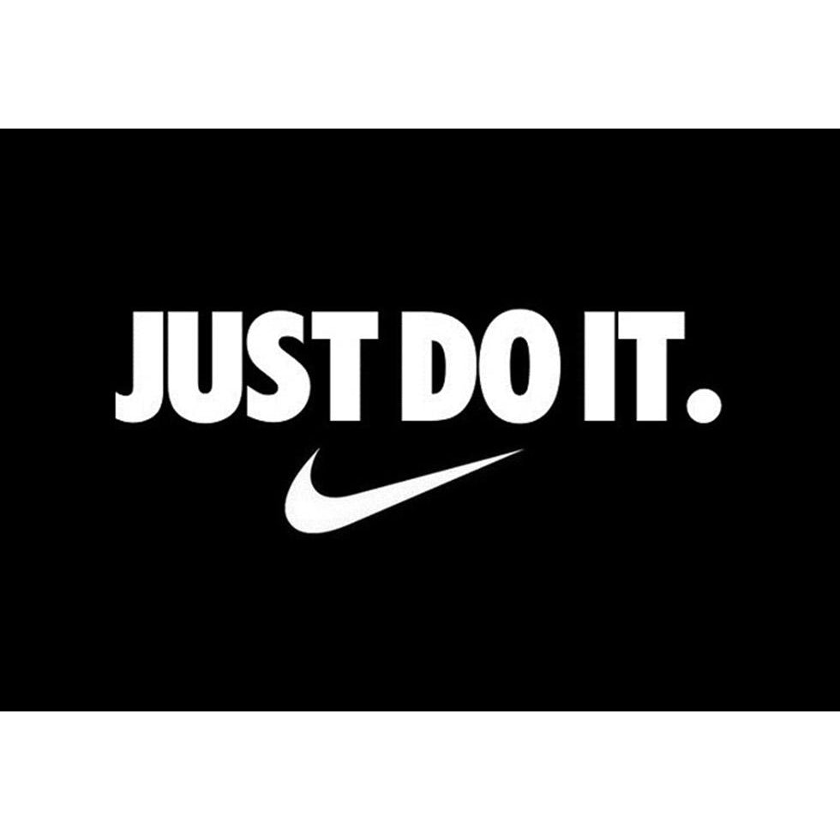
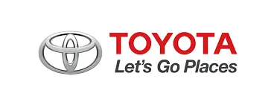
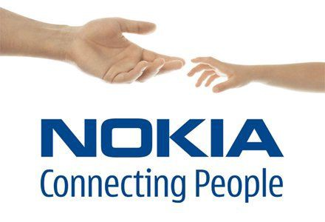
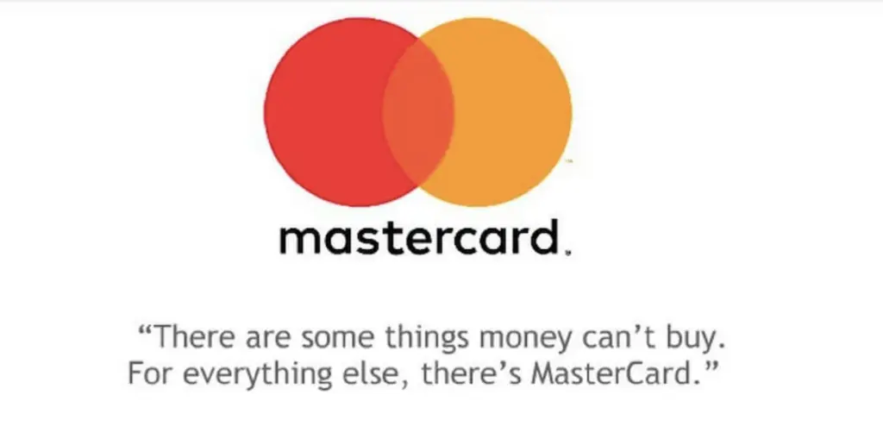
Let’s go places
JUST DO IT.
There are some things money can’t buy. For everything else, there’s M...
Connecting People
I’m lovin’ it
Notes:
Promotion refers to "the marketing communication used to make the offer known to potential customers and persuade them to investigate it further". Promotion elements include "advertising, public relations, direct selling and sales promotions."

Slide 50
Discussion 3 – Marketing mix
Does your univeristy use some marketing concepts? Which? What is the target audiance?

Slide 51
Thank you for your attention!
Martin Cabrada
Czech University of Life Sciences Prague
cabrada@fld.czu.cz
+420 601 384 817

