Slide 1
Non-timber forest product management
Ing. et Ing. Markéta Kalábová, Ph.D.
Faculty of Forestry and Wood Sciences
Czech University of Life Sciences in Prague
25. 1. 2023

Slide 2
Content
Introduction of lecturer
Introduction to the topic
Characteristics and definitions of NTFP
EU strategies and European approach
Best practices
Discussion

Slide 3
Introduction of lecturer
University of Economic, University of Life Sciences
Assistant professor at Faculty of Forestry and Wood Sciences
Vice-dean for Education
Research focus: economics – tourism (hunting tourism), recreational function of forest, bioeconomy

Slide 4
Kahoot

Slide 5
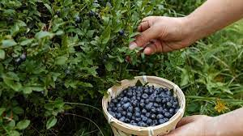
Non-timber forest products
The United Kingdom's Forestry Commission defines NTFPs as "any biological resources found in woodlands except timber„
"materials supplied by woodlands - except the conventional harvest of timber"
include wild and managed game, fish, and insects
NTFPs are commonly grouped into categories such as floral greens, decoratives, medicinal plants, foods, flavors and fragrances, fibers, and saps and resins
Non-Timber Forest Products (NTFPs) are defined as "all biological materials, other than timber, which are extracted from forests for human use."
Non-Wood forest products (NWFPs) are a subset of NTFP; they exclude woodfuel and wood charcoal
Both NWFP and NTFP include wild foods
Notes:
In projects in Scotland – second definition

Slide 6
Non-wood forest products definition
In 1999, FAO defined NWFPs as “goods of biological origin other than wood derived from forests and other wooded land and trees outside forests”(Unasylva, 1999).
FAO’s Forest Resource Assessment (2015) defines NWFPs as “Goods derived from forests that are tangible and physical objects of biological origin other than wood” to increase consistency in country reporting.
“wild and semi-wild non-wood forest species and products there of, as well as products in the early stage of domestication […] and with reference to specific services related to NWFPs […]” (Wolfslehner et al., 2019
Notes:
Different variations of the term, like secondary, minor or non-timber forest products (NTFP) are also used by governments, institutions and academics, depending on needs and objectives.
- forest products include wild forest products, minor forest produce, special, minor, alternative and secondary forest products
decorations, nursery and landscaping products, fine art, and crafts.
Billions of people worldwide depend on NTFP, either by direct consumption or as a source of income.
These products are relatively invisible in national statistics.
This under-reporting obscures the role they play in poverty reduction, food and health security, and social stability.

Slide 7
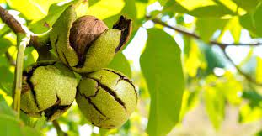
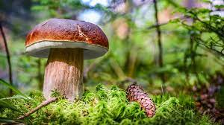
Non-wood forest products definition
Examples of NWFPs include products used as
food and food additives (edible nuts, mushrooms, fruits, herbs, spices and condiments, aromatic plants, game),
resins, gums, and plant and animal products used for medicinal, cosmetic or cultural purposes

Slide 8
Examples
Mushrooms and truffles
Forest berries
Wild edible nuts
Bamboo shoots
Maple sugar and syrup
Bark.
Bark used in perfumery or pharmaceuticals
Bark used for plaiting, dyeing and tanning
Latexes
Gums and resins
Bamboo and rattan
Cork
Hides, skins and trophies
Edible insects
Wild meat
Other NWFPs

Slide 9
Why to consider NWFP
Climate change
Land-use changes
Uncontrolled or untrained harvesting - over-exploitation -
unsustainable and damaging practices
Lack of a well-trained workforce
Illegal or informal trade
Notes:
is affecting the vitality, structure and function of forest and other woodland ecosystems, and thus, the availability of NWFPs.
Of special concern are the impacts of ongoing reduction of precipitation – drought cycles – and increased aridification reducing NWFP availability and quality while increasing seasonality, jeopardising supply chains, as well as territorial marketing strategies.
In addition, climate change and global trade are accelerating the spread of exotic and local pests and diseases.
Some worrisome cases include the decay of resin-tapped maritime pine (Pinus pinaster) in Portugal caused by the fatal pine wood nematode (Bursaphelenchus xylophilus), reduced production of pine nuts and chestnuts across the Mediterranean due to the western conifer seed bug (Leptoglossus occidentalis) and the chestnut gall wasp (Dryocosmus kuriphilus), respectively; and the greatly reduced quantity and quality of cork due to the flatheaded borer (Coraebus undatus) or the gypsy moth (Lymantria dispar)
3) As an example, untrained or unprofessional cork-stripping or resin-tapping operations can lead to tree damage and ruin product quality and quantity for the remaining life of trees. Also, rural abandonment, loss of traditional knowledge, low profitability, seasonality, and remote location of the workplace, put additional barriers to the professionalisation of NWFP collectors.
4) most wild products come, at least in Europe, from manged forestry and agroforestry systems

Slide 10
Non-timber forest products importance
NWFPs are a central element of sustainable development and sustainable forest management.
fragmented data and persistent knowledge gaps
increasing evidence on the significant potential of NWFPs to contribute to the 17 SDGs, notably regarding their social and cultural, environmental and economic dimension, as described below.
Notes:
These concepts have been highlighted in international agreements since the Rio Summit (1992), such as in the Second and Third European Ministerial Conferences on the Protection of Forests in Europe (in particular Helsinki, 1993, and Lisbon, 1998).

Slide 12
Social and cultural dimensions
The collection and production of NWFPs are part of Europe’s cultural heritage.
Recent research shows that 90% of European households regularly consume NWFPs, while 26% collect some type of NWFP, at least once a year, for self-consumption or sale.
NWFPs contribute to health and well-being
NWFPs sustain household economies
In 2015, the economic value of marketed NWFPs in Europe was €4 billion, nearly 20% the value of marketed roundwood
Moreover, by including informally marketed and self-consumed products, the value of that figure may rise to some €23 billion yr-1, which exceeds, by far, the revenues from roundwood.
Around 85% is used for self-consumption, while the remaining 15% is sold in formal and informal markets, for an estimated €3.5 billion
NWFPs contribute to social integration, gender balance, and equality
Notes:
This makes up for more than 60 million European foragers, often organised in dynamic associations, such as those of mushroom pickers. These outdoor activities are the continuation of centuries-old traditional uses and knowledge, spiritual and cultural dimensions, as unique culinary traditions, and more active personal lifestyles.
Many NWFPs are part of traditional food systems, nutritious, adapted to local conditions, and increasingly contribute to local, regional, and international food value chains
While the forestry and timber sector, which directly employs some 3.8 million people in Europe, is clearly male dominated, in the collection, transformation, and trade of many NWFPs such as medicinal and aromatic plants (MAPs), women play a more central role. Harvesting NWFPs also provides rural jobs, and an important source of income for people that do not have many alternatives.

Slide 13
Environmental dimension
NWFPs contribute to sustainable land management
NWFPs diversify forests management in Europe
Over 5 million hectares (Mha) of forests are primarily managed for the production of different NWFPs or for coproduction with timber, pastures or other ecosystem services, including agroforestry systems.
NWFPs are instrumental in maintaining high biodiversity value agro-ecosystems and other priority habitats
Notes:
Most NWFPs are collected in forests not managed only for NWFP production; they provide complementary sources of income that are especially relevant in areas prone to wildfires and areas where timber value is low
Expanding the area of forests managed for NWFPs offers interesting opportunities for management and habitat diversification
Active co-management for NWFPs, contributes to the maintenance of habitat types of European interest

Slide 14
Economic dimension
the annual global income from NWFPs was estimated at US$88 billion (€67 billion) in 2011
NWFP supply raw materials for bio-based industrial sectors
Europe is a key player in the NWFP trade
The legally declared international trade of NWFPs is in the range of €8.7 billion per year. The EU accounts for almost half of the imports (€4.2 billion) and 40% of exports (€3.4 billion), though domestic productions are not reflected in these international trade statistics
Europe imported raw plant material with a value of €2.5 billion, 70% derived from wild collection of MAPs from developing countries
Notes:
Economic dimension - The current and potential economic dimension of NWFPs escapes statistics and foresights, as many NWFPs are part of the informal economic or registered as agricultural products in official records. Nevertheless, the annual global income from NWFPs was estimated at US$88 billion (€67 billion) in 2011. Including the value of self-consumption and recreation could increase the figure by an order of magnitude.
2) Cork is the second most relevant export sector in Portugal (€1.2 billion, i.e., 61% of world cork exports). Natural tannins are a key element of the Italian leather industry. MAPs are playing an increased role in the cosmetics, nutraceutical, and pharmaceutical markets. Valued at €78.6 billion (2018), the European cosmetics and personal care market is the largest in the world, offering enormous potential for development
The legally declared international trade of NWFPs is in the range of €8.7 billion per year. The EU accounts for almost half of the imports (€4.2 billion) and 40% of exports (€3.4 billion), though domestic productions are not reflected in these international trade statistics. Europe is the global leader in the supply of cork and cork-based products, sweet chestnuts, and Mediterranean pine nuts, and is a relevant player in the markets for truffles, vegetable tannins, and wild mushrooms. For most NWFPs, however, Europe is a net importer. In 2014, for instance, Europe imported raw plant material with a value of €2.5 billion, 70% derived from wild collection of MAPs from developing countries

Slide 15
Economic importance
Several million households world-wide depend heavily on NWFP for subsistence and/or income.
Some 80 percent of the population of the developing world use NWFP for health and nutritional needs.
Women from poor households are generally those who rely more on NWFP for household use and income.
At a local level, NWFP also provide raw materials for large scale industrial processing.
Some NWFP are also important export commodities. At present, at least 150 NWFP are significant in terms of international trade, including honey, gum arabic, rattan, bamboo, cork, nuts, mushrooms, resins, essential oils, and plant and animal parts for pharmaceutical products.
Globally, an estimated 3.5 to 5.8 billion people, across socio-economic groups and geographic regions, use wild plants, and one billion depend on wild foods for their livelihoods and food security. Wild plants offer great economic and nutrition opportunities for these communities and for societies around the world.

Slide 16
Current situation
For NWFPs mainly collected in the wild, increased demand may lead to unsuitable harvest levels, uncontrolled trade, biodiversity loss, and resource depletion.
It could also generate conflicts between local communities and professional NWFPs collectors.
For NWFPs produced in managed forest ecosystems, lack of supply is related to abandonment of forest management or intensification of agriculture in agroforestry systems, both in response to reduced profitability of primary production in absence of compensation or common-good ecosystem services they provide.
Urgent action is needed to protect and enhance the resource base, to promote sustainable forest management, including sustainable harvesting practices and improved monitoring systems

Slide 17
Demand for many NWFPs increased
need to reduce dependence on non-renewable resources and to transit towards a sustainable circular bioeconomy;
renewed interest in natural ingredients for healthy diets and personal care;
surge in demand for traditional products with strong cultural heritage;
growing interest in experiential services in tourism or recreation, such as wild food gathering.
Bioproducts or bio-based products are materials, chemicals and energy derived from renewable biological material.
Notes:
This demand is driven by:

Slide 18
Europe’s policy priorities - NWFPs
nature-based solutions that protect and restore biodiversity for the benefit of nature and people
The European Green Deal (2019)
NWFPs can help in the transition towards a carbon neutral, circular, and bio-based economy.
The post 2020 Common Agricultural Policy (CAP)
“sustainability, safeguarding agriculture’s position at the heart of Europe’s society”
Support of Agroforestry
The New Industrial Strategy for Europe
NWFPs can provide raw materials and high value molecules for different industrial sectors and notably, the green chemical industry
Notes:
3) NWFPs can provide raw materials and high value molecules for different industrial sectors and notably, the green chemical industry.
They can support the “Mid Century Vision 2050” of the European chemical industries, that identifies increased sustainability, reduced emissions, and circularity as some of its key challenges.
Natural Origin ingredients can also play an increased role in the mission of the European cosmetics industries to support sustainable development, “reducing environmental footprint, creating quality jobs, and enhancing the social value for communities where products are sourced, manufactured (including value chain), or purchased”, increasing the reliance of the cosmetics industries on natural and organic ingredients.
NWFPs such as cork, natural resin, and tannins can also play a role in greening the construction, manufacturing, and fashion sectors

Slide 19
Europe’s policy priorities - NWFPs
The EU Biodiversity Strategy for 2030
sets ambitious targets for protecting nature and reversing the degradation of ecosystems and aims to: expand and effectively manage protected areas (up to cover 30% of land area); expand agro-ecological practices (to over 25% of the productive land area); reduce pesticide use by 50%; and restore land under organic management practices
The Pharmaceutical Strategy for Europe (2020)
intends to provide affordable, accessible, and safe medicines for all, supporting competitiveness, innovation, and sustainability of the EU’s pharmaceutical industry.
The EU Farm to Fork Strategy (2020)
aims at more healthy, affordable, and sustainable food for Europeans in 2030.
Notes:
3) Forests are a key component of food security at a global level, as recognised by the FAO30 and the Committee on World Food Security, and can also play an important role in food production, and vibrant food and gastronomic value chains, embedded in cultural and natural heritage.
Extensive agroforestry systems, truffle cultivation, mushroom gastronomy, exemplify this potential.
Increased attention to NWFPs can also generate new opportunities to decarbonise the food sector and create other environmental benefits and support viable agroforestry systems

Slide 20
Europe’s policy priorities - NWFPs
The EU Forest Strategy
aims at promoting sustainable forest management in support of biodiversity conservation and climate change mitigation and other ecosystem services, and the provision of sustainable growth and jobs to support rural development
EU Climate Action
heart of the European Green Deal
climate-smart forestry is applied
Notes:
Simply said, in the absence of NWFPs value chains, it would not be possible to achieve those objectives in most European regions. Moreover, considering that Europe is the main importer of NWFPs, sustainable and fair trade of NWFPs can play a very significant contribution to preserving and restoring forests outside Europe, in line with the intention to Step-up EU action to Protect and Restore the World’s Forests (2019)34 and the proposed EU Forest Partnerships
is at the heart of the European Green Deal. The 2050 climate-neutrality objective will not be reached unless: active multi-purpose forest management is pursued; climate-smart forestry is applied; non-sustainable products are replaced by sustainable products; the role of agroforestry is promoted; there is a closer integration of forestry and agricultural activities; and more resilient landscapes are created.

Slide 21
NWFPs include
wide variety of products that feed into a wide diverging range of chains (food, feed, chemistry, pharmaceuticals, cosmetics, clothing, construction, etc.)
services (e.g. ecotourism, recreation, gastronomy, etc.);
they are produced in many ways, from wild collection to different stages of domestication and cultivation;
they encompass a wide range of land uses, from forests and agroforestry systems to other wooded land; and they present many different business models, with varied sizes and degrees of professionalisation and vertical or horizontal integration
high degree of policy fragmentation.
Notes:
In short, the cross-sectoral reach, and the boundary nature of many NWFPs, results in a high degree of policy fragmentation.

Slide 22
A need to secure sustainable harvesting and fair trade
tropical and subtropical regions, NWFPs can represent a significant income for rural people
sustainable harvesting and trade (detrimental effects on environmental quality and social equitability, promoting ‘unsustainable harvesting’ or ‘imported deforestation’ in supplier countries
Governments/operators and sectoral organisations must
strengthen their sustainable supply,
increase transparency to address the risks of illegal or unsustainable harvesting,
submerged economies, social conflicts, compliance with labour standards
implement traceability to guarantee food safety and resource sustainability.
Notes:
In many areas of the world, notably in tropical and subtropical regions, NWFPs can represent a significant income for rural people.
As the leading importer of NWFPs, Europe is responsible for sustainable harvesting and trade in the countries of origin.
Without guarantees of sustainable forest management and labour conditions in these countries, NWFP consumption in EU markets might have unknown detrimental effects on environmental quality and social equitability, promoting ‘unsustainable harvesting’ or ‘imported deforestation’ in supplier countries.
The responsibility does not rely only with governments. NWFP operators and sectoral organisations must….

Slide 23
Bioeconomy
Bioeconomies emphasize the use of renewable natural resources to sustainably provide products.
A bioeconomy can reduce the environmental impact of economic growth.
Science-based management promotes sustainable harvests and production.
Bioeconomy-based tourism

Slide 24
Actions to achieve core policy objectives
Securing conservation and sustainable supply of NWFPs, addressing the risk and negative impacts derived from climate and social change, including increased pressures on resources, unsustainable practices, and the erosion of cultural heritage.
Support viable, competitive, and transparent value chains for the integration of rural and urban economies, ensuring sufficient and equitable returns for local communities, land and forest managers/owners, harvesters, and a fair distribution of profit along the value chain.
Ensure transparency on material and economic flows, through improved data collection, and through adequate classification, labelling and communication over NWFP origins, qualities, and trade.
Provide the necessary conditions to support all actions in a coherent policy environment and an active and capable governance framework

Slide 25
Best practices
Truffles in Poland
Truffles in Italy
Mushrooms in Spain
Orchards in cities

Slide 26
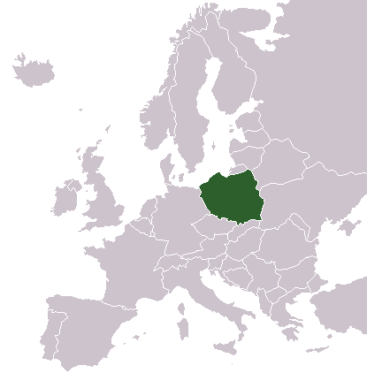
Truffles in Poland
Truffle (Tuber spp.) is economically and culinary valued fungi
Truffles in Poland has a long tradition
Polish State Forests supported the establishment of truffle orchards by the Forestry Research Institute
Poland Forestry
Largest forest area (9,4 million ha) in Europe
Timber is the main product derived from Polish Forests (best stocked in Europe)
Non-wood forest products – forest fruits (mainly berries), mashrooms, game animals
Free public access

Slide 27
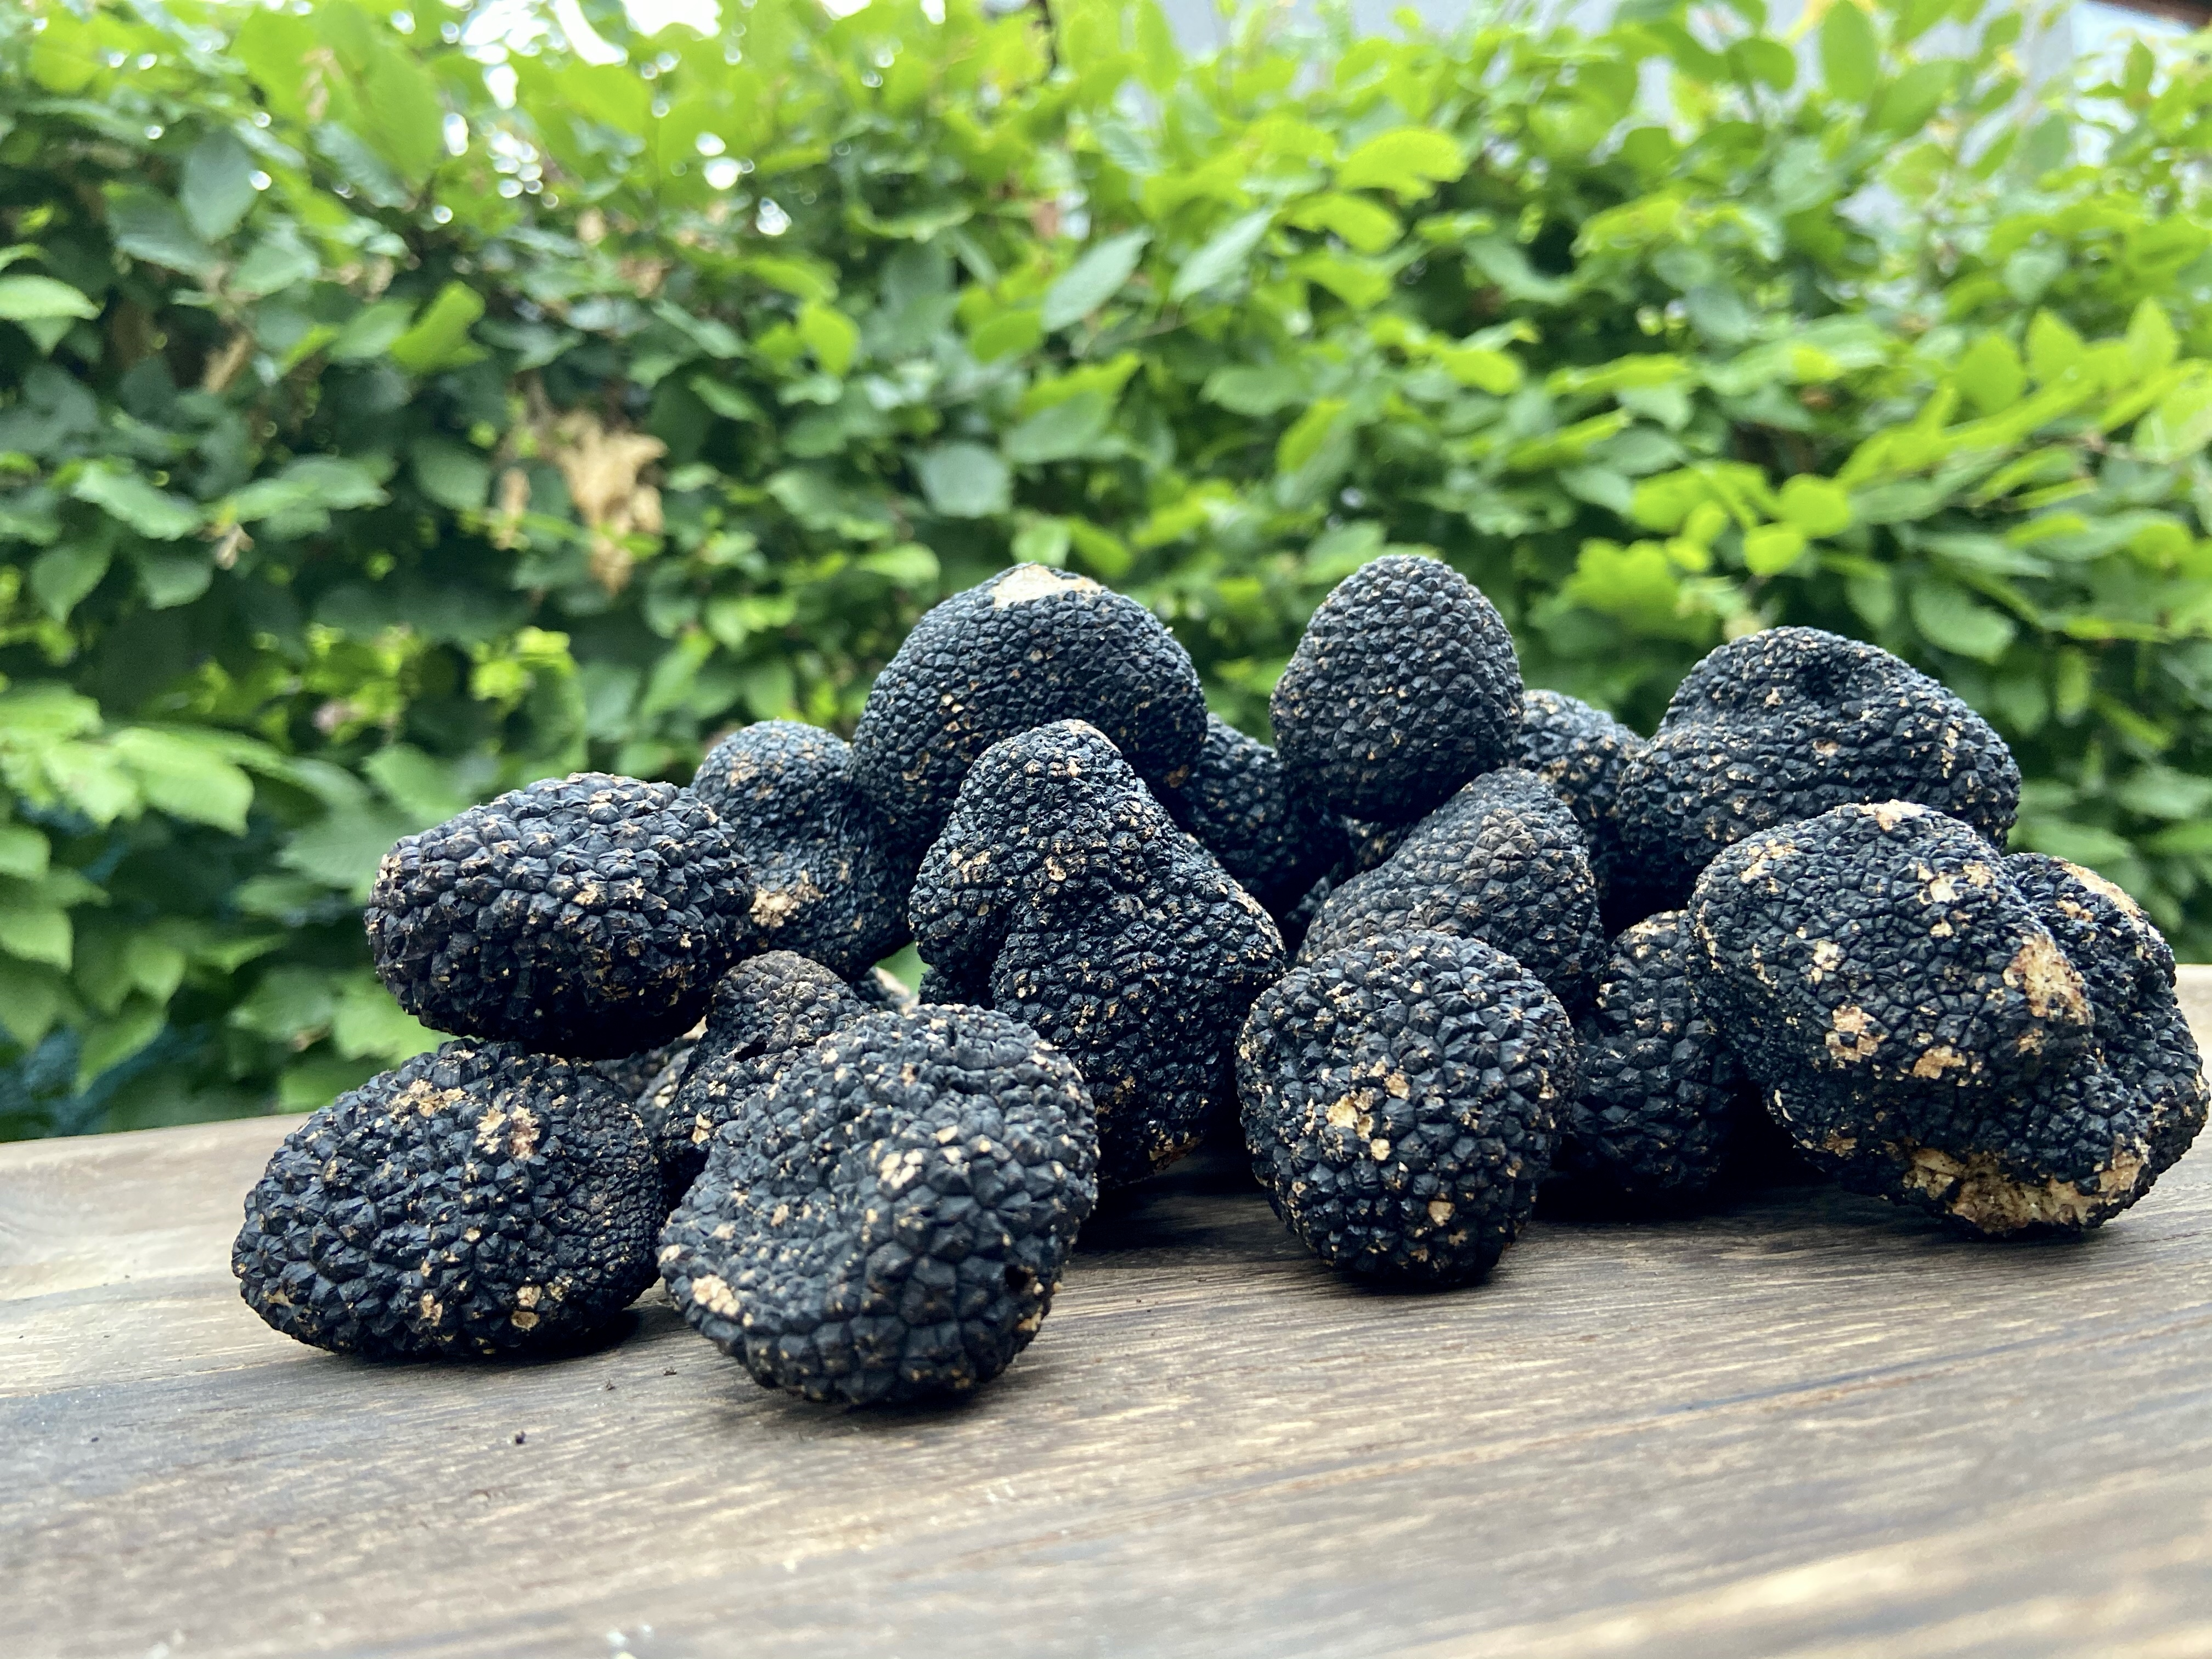
Truffles in Poland
Social functions of forests are difficult to define and measure, which include recreation, tourism, education, and various traditional uses
The State Forests place substantial efforts into raising public awareness of recreational and educational infrastructure available in forests, including:
parks and arboreta (of which there are 17 in Poland),
centres for ecological education (over 20),
educational rooms (50),
scenic viewpoints (318)
nature paths (over 150).
Notes:
The State Forests place substantial efforts into raising public awareness of recreational and educational infrastructure available in forests, including: parks and arboreta (of which there are 17 in Poland), centres for ecological education (over 20), educational rooms (50), scenic viewpoints (318) and nature paths (over 150).

Slide 28
Truffles in Poland
It is estimated that there are over 1000 species of edible mushrooms in Polish forests.
tradition of Polish culture (knowledge traditionally passed down from generation to generation)
need a host plant to develop
grow best in calcareous, mainly rendzic soils
found with the help of trained dogs or pigs
Notes:
Their collection has a centuries-long tradition and an established place in Polish culture. Knowledge about mushrooms has traditionally been passed down from generation to generation. However, with the modernization of the country and an increase in the standard of living, knowledge and skill concerning the collection of edible mushroom species has been waning in recent years
Unfavorable conditions for fruiting truffles included changes in species composition, age structure of stands, and changes of forest management. For example, undergrowth shading the forest floor was more common due to the cessation of grazing in forests. (ii) Changes in the structure of forest ownership and use. The disappearance of traditional types of forest use, such as cattle grazing and collection of brushwood.
Truffles as a luxury product for the nobility were not welcomed by new authorities
As a type of mycorrhizal fungi, truffles need a host plant to develop, grow best in calcareous, mainly rendzic soils, and, because they grow up to 30 cm deep in the soil, they need to be found with the help of trained dogs or pigs

Slide 29
Truffles in Poland
truffle orchards perceived as a new source of benefits in agroforestry
incentives for planting oak and hazel (main host-plant species).
truffle cultivation can contribute to a stable bioeconomy
highly competitive character
Truffle orchards are established
Notes:
Although establishing of truffle orchards is still in pioneer phase, such an activity is perceived as a new source of benefits in agroforestry.
The possibility to grow and collect truffles is important for increasing rural economy and thereby the incentives for planting oak and hazel (main host-plant species). Truffle cultivation can contribute to a stable bioeconomy, both supporting the high biodiversity associated with Quercus spp. [13] and contributing to local economy of rural areas.
Mushroom collection is more similar to hunting, usually a male domain, than collecting berries or herbs, as the appearance of fungal fruiting bodies is temporal [10]. A strong element of chance is thus introduced, making mushroom gathering more exciting and due to the fact that it has a highly competitive character

Slide 30
Truffles in Italy
win–win agreement between landowners and a truffle picker association
owner maintains his property rights and receives rents
truffle picker association manages the land and reserves the truffle harvesting right for its members, who pay an annual fixed fee.
forest system that would have been abandoned is now actively managed.
Notes:
In the Italian Apennines, near Bologna, a win–win agreement between landowners and a truffle picker association, ‘Associazione Il Tartufo Bologna’, has emerged as a successful case study. Thanks to a lease agreement, the owner maintains his property rights and receives rents, while the truffle picker association manages the land and reserves the truffle harvesting right for its members, who pay an annual fixed fee. As a consequence, a forest system that would have been abandoned is now actively managed. In Spain, the national Forest Law-43/200339, clarified that mushrooms were also ‘fruits of the land’ and thereby property of the landowner, if she or he wishes to declare it and protect it as such. This allows private and public owners to establish who can harvest, in what amounts, and under what circumstances (authorisation, communication).

Slide 31
Mushrooms in Spain
mushrooms are ‘fruits of the land’ and thereby property of the landowner
private and public owners can establish who can harvest, in what amounts, and under what circumstances (authorisation, communication)
system of mushroom picking permits
700 000 ha of forests have been grouped into mushroom management units
100 000 picking permits are sold every year (€6 per weekend)
main objective of the system is to generate tourism rather than direct income from NWFPs
Notes:
Building upon this framework regulation, the region of Castilla y León (Spain) established a system of mushroom picking permits in 2003, widely accepted on a voluntary basis, and finally officially recognised by Regulation 31/2017 of mycological resources. More than 700 000 ha of forests have been grouped into mushroom management units and around 100 000 picking permits are sold every year, at an average price of €6 per weekend. Another 5,000 permits are commercially oriented and allow the pickers to sell their harvest to markets, and 25 local processing enterprises collectively manage the quality label ‘Mushrooms of Castilla y León’. Forest owners, mostly municipalities, dedicate the largest proportion of the revenues from permits (around €750 000 yr-1) to maintenance, promotion and research, since the main objective of the system is to generate tourism rather than direct income from NWFPs.

Slide 32
Tourism sector – recreational function of forests
Tourism and especially ecotourism strategies, can greatly benefit from increased interest in wild and traditional products
opportunity to generate synergies among services and products of a territory, making a tourism destination, more attractive, and expanding the markets for NWFPs-based products, experiences and other services
well-recognised brand
‘Town of mushrooms’, with museums and restaurants dedicated to wild mushrooms and festivals, surveys, and training activities by local associations
app, Micodata GIS-Europe, which provides information on mycological yield, resources, and services, mycology-related cultural events, and information on areas where harvesting requires permits. This is just one of many examples of technological developments and digitalisation of NWFP-related services
Notes:
Realise synergies with tourism in territorial development strategies. Tourism and especially ecotourism strategies, can greatly benefit from increased interest in wild and traditional products, as well as in experiential activities in rural areas. This opens up the opportunity to generate synergies among services and products of a territory, making a tourism destination, more attractive, and expanding the markets for NWFPs-based products, experiences and other services, frequently supported by a well-recognised brand, such as ‘Traditions and Flavours of Modena’, or the ‘Strada della mela e dei sapori delle valli di Non e di Sole’ 55. Inspiration can be drawn from an increasing number of successful examples and tools for mycotourism, that can be found all over the Mediterranean (Box 4).

Slide 33
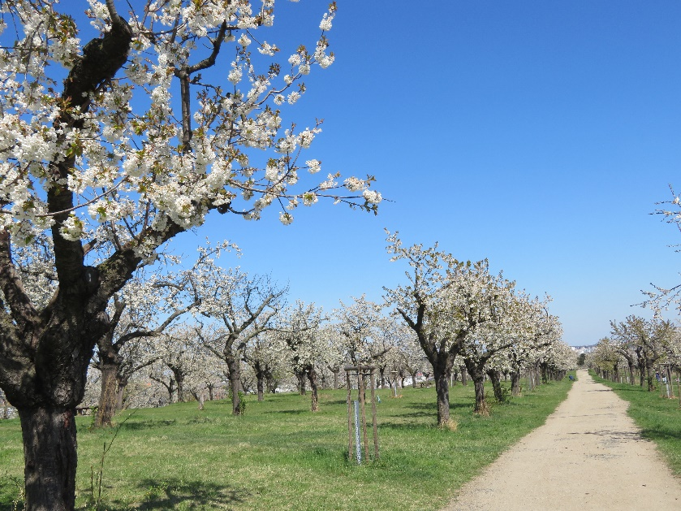
Orchard in cities
traditional urban fruit orchards (dominated by Cherry (Prunus avium), Apple (Malus domestica), Pear (Pyrus communis) or Plum (Prunus domestica) trees with partial representation of Walnut (Juglans regia)
Orchard management
Abandoned orchards - cover of shrubs in understorey, missing fruit trees in regular spacing and natural regeneration of shrubs and forest trees (e.g., ash, oak, maple) in crown gaps.
Restored orchards were with renewed regular spacing (i.e., dead trees were replaced by new ones), and understorey managed as meadow with partial pasturing of sheep or goats.
Notes:
Abandoned orchards (i.e., new wilderness) were almost with dense cover of shrubs in understorey, missing fruit trees in regular spacing and natural regeneration of shrubs and forest trees (e.g., ash, oak, maple) in crown gaps. Restored orchards were with renewed regular spacing (i.e., dead trees were replaced by new ones), and understorey managed as meadow with partial pasturing of sheep or goats.

Slide 34
Orchard in cities
Fragmented habitats of traditional fruit orchards are important for dead-wood dependent beetles associated with open canopy deciduous woodlands
important and biodiverse part of the anthroposphere
Actual trends in ecosystem restoration are often toward the new wilderness.
The majority of citizens in our study were for restoration of urban fruit orchards.

Slide 35
Orchard in cities
Orchards are formerly established as agroforestry habitat
the commercial function was the second most important
citizens determined recreation-aesthetic function as the most important role for urban orchards
Citizens like to walk or walk the dogs in this aesthetical urban environment
The willingness to pay is also connected with the possibility of improvements in orchards

Slide 36
Agroforestry
Agroforestry is a method of farming on agricultural or forest land that combines the cultivation of woody plants with some form of agricultural production on one plot of land, either spatially or temporally.
The condition is that the components of the agroforestry system (timber, crops, animals, or others) are grown or bred with an economic and/or environmental purpose.
Agroforestry systems are methods of management close to nature in an agrarian landscape combining plant and animal production with wood production.

Slide 37
Agroforestry
landscape's resistance to drought and erosion,
stabilizes the microclimatic conditions of the landscape,
resistance to climatic extremes (drought, heat, drying winds, torrential rains),
contributes favorably to increasing biodiversity and improving a wide range of non-production functions
it creates very aesthetic elements in the landscape
Notes:
Agricultural management with targeted tree planting increases the landscape's resistance to drought and erosion, stabilizes the microclimatic conditions of the landscape, thereby increasing its resistance to climatic extremes (drought, heat, drying winds, torrential rains), contributes favorably to increasing biodiversity and improving a wide range of non-production functions .

Slide 38
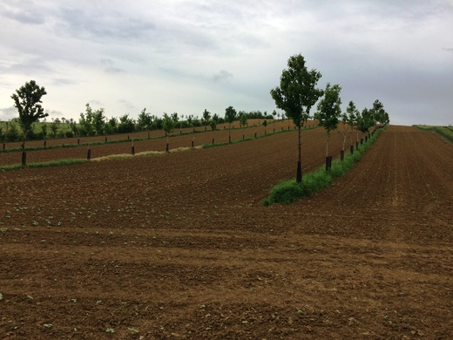

Slide 39
Agroforestry
Examples of European Agroforestry systems
- here

Slide 40
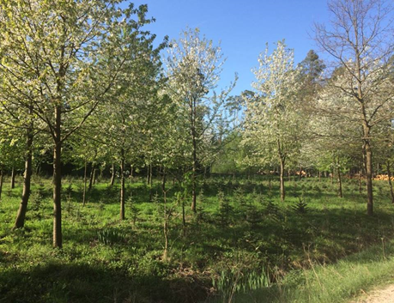
Economically viable Agroforestry systems
their long-term fulfillment - tree care - must be fulfilled
qualitative production depends on the choice of individual tree species depending on the habitat, growth conditions and mainly on the genetic prepositions of the tree species
Notes:
In order for ALS to be economically viable, their long-term fulfillment - tree care - must be fulfilled. The assumption of volume or qualitative production depends on the choice of individual tree species depending on the habitat, growth conditions and mainly on the genetic prepositions of the tree species.

Slide 41
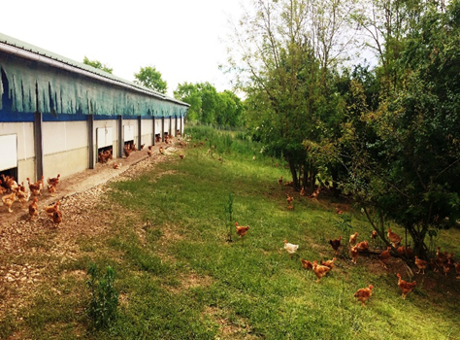
Egg production
Sustainable egg production is currently a big topic
laying hens' environment
egg quality and profitability of production.
combination of chicken farms for egg production and the cultivation of valuable or firewood
Notes:
Sustainable egg production is currently a big topic. In the future, it will be necessary to find optimal conventional methods of egg production on the one hand and, on the other hand, to balance the comfort of the laying hens' environment, egg quality and profitability of production. Agroforestry methods are directly offered. The combination of chicken farms for egg production and the cultivation of valuable or firewood creates an ideal environment for chickens while contributing to the biodiversity of the landscape.

Slide 42
Grazing of domestic pigs
controlled grazing of domestic pigs that fed on acorns and beech trees
common practice in Germany (the best ham grows on acorns)
forest grazing is prohibited in Czech forests, unless an exception is granted to the owner of the forest
Notes:
controlled igs that fed on acorns and beech trees. In other states, this method of fattening pigs is a common practice. In Germany, it has even developed into such a social consciousness that they say that the best ham grows on acorns. However, forest grazing is prohibited in Czech forests, unless an exception is granted to the owner of the forest. For these reasons, I classify this type of forest as ALS.

Slide 43
Regional sale of agricultural products and gastronomy
Production from agroforestry systems can be very varied
multifunctionality,
direct sales to restaurants that specialize in regional gastronomy from agroforestry products
agritourism
Notes:
Production from agroforestry systems can be very varied. Thanks to its multifunctionality, it can be used both for larger agricultural companies and, above all, for smaller farmers who focus on regional sales. The highlight of ALS production can then be direct sales to restaurants that specialize in regional gastronomy from ALS products, which is linked to agritourism, which will contribute to sustainable business in the countryside and its development. There are simply too many options. The basis is to use the local natural, soil and landscape conditions and combine them with the corresponding spectrum of trees that would correspond to the vision of the owner and his business plan.

Slide 44
Next steps and strategies
Further clarify definition and classification issues
Strengthen collaboration between FAO and the international agencies responsible for the maintenance, updating and revision of reference classification of products
Improve awareness of and collaboration regarding data collection on NWFPs
Work on developing methodologies to capture, estimate and analyse statistics on NWFPs’ informal sector and self-consumption
Facilitate capacity development and knowledge exchange between FAO and statistics end-users.
Notes:
Further clarify definition and classification issues
Improve awareness of and collaboration with national statistical agencies, trade associations, CITES national management authorities and related entities regarding data collection on NWFPs and associated terminology challenges
In order to harmonize the data, strengthen collaboration between FAO and the international agencies responsible for the maintenance, updating and revision of reference classification of products, UNSD and WCO.
Work on developing methodologies to capture, estimate and analyse statistics on NWFPs’ informal sector and self-consumption
Facilitate capacity development and knowledge exchange between FAO and statistics end-users.

Slide 45
Forest management
Management systems in these forests (with the higher production of different NWFPs) are generally extensive and multi-functional, with low environmental impacts, as harvesting levels are monitored and regulated.
Expanding the area of forests managed for NWFPs offers interesting opportunities for management and habitat diversification
The active, multi-functional management of these expanding forests is the first necessary step to guarantee healthy, sustainable ecosystems, and to achieve a balance of goods and services to address societal demands, and minimise the disservices.
Specifically, increased emphasis is needed in sustainable multi-purpose forest management to ensure the complementarity of providing wood as well as NWFPs and other ecosystem services:
efforts should focus on an active management and diversification of those planted and the spontaneously expanding young forests, in order to overcome simplified ecosystems (single-cohort plantations, for increasing their resilience and value, and transitioning from timber-oriented forestry towards an integrated, more flexible multifunctional forest management at the landscape scale

Slide 46
From traditional Forestry to multifunctional forest management
long-term return on investments needed for the active management of spontaneous and planted forests or to address the lack of private profitability
green investments – frequently restricted to specific issues like afforestation, carbon forestry, or wildfire prevention – to the multi-functional management of new, spontaneous or planted forests.
Agroforestry habitats are especially rich in NWFPs

Slide 47
Main resources and materials
Gregory E Frey, Susan J Alexander, James L Chamberlain, Keith A Blatner, Alisa W Coffin, Rebecca J Barlow, Markets and Market Values of Nontimber Forest Products in the United States: A Review, Synthesis, and Identification of Future Research Needs, Journal of Forestry, Volume 117, Issue 6, November 2019, Pages 613–631, https://doi.org/10.1093/jofore/fvz051
Horak J. (2014) Fragmented habitats of traditional fruit orchards are important for dead-wood dependent beetles associated with open canopy deciduous woodlands. Naturwissenschaften 101:499–504. doi:10.1007/s00114-014-1179-x.
Bailey, D., Schmidt‐Entling, M. H., Eberhart, P., Herrmann, J. D., Hofer, G., Kormann, U., & Herzog, F. (2010). Effects of habitat amount and isolation on biodiversity in fragmented traditional orchards. Journal of applied ecology, 47(5), 1003-1013.
Herzog, F. (1998). Streuobst: a traditional agroforestry system as a model for agroforestry development in temperate Europe. Agroforestry systems, 42(1), 61-80.
Krčmářová, J., & Jeleček, L. (2017). Czech traditional agroforestry: historic accounts and current status. Agroforestry Systems, 91(6), 1087-1100.
https://ntfp.org/

Slide 48
Wrap-up
(NWFP) considered as a key element of the green economy in Europe and worldwide
“The forests are our most important terrestrial natural capital but to unlock the forest potential we need to stop looking at our forest with the old paradigm lenses, with fossil economy lenses. As a compensation for a broken economic system, we need to start using circular bioeconomy lenses and then we will see that forests are not only our most important carbon seam or the main host for biodiversity. They are also an amazing source for healthy food, biomedicine, and biological resources such as wood, corks, resins that with emerging technologies can be transformed in a total new range of bio-based solutions. So, they play a crucial role to decarbonize our economy.” Marc Palahì, Director of the European Forest Institute (EFI).
Despite all the opportunities that the NWFP offer, they face significant challenges such as the lack of systematic knowledge, regulation and management, the climate change is already affecting them, the uncontrolled or unsustainable harvesting of wild products, the illegal trade that is a driver of unsustainable practices, the change of land use, among others, as the experts point out.

Slide 49
Indeed, the non-wood forest products are a central element of sustainable development and sustainable forest management. They contribute to the United Nations Sustainable Development Goals (SDGs) in the social and cultural, environmental, and economic dimensions; and notably to rural development, nature conservation, human well-being,
The legally declared international trade of NWFPs is in the range of €8.7 billion per year, and in this respect, Europe is a key player. The European Union (EU) accounts for almost half of the imports (€4.2 billion) and 40% of exports (€3.4 billion), though domestic productions are not reflected in these international trade statistics.

Slide 50
naturally Agroforestry system fulfills management based on the principles of sustainable development
contribute positively to mitigating the negative effects of global climate change while improving the quality and variety of our landscape
supported by FAO (The Food and Agriculture Organization) and FOREST EUROPE is proof that ALS is a global and European issue.

