Slide 1
Project management

Slide 2
Project management
The aim:
Increase awareness about project management principles.
Try out some project management tools.

Slide 3
What is a project?
“A project is a unique, temporary, multidisciplinary and organised endeavour to realise agreed deliverables within predefined requirements and constraints.“ (IPMA)
“Project is a temporary endeavor undertaken to create a unique project service or result.“ (PMI)
“Project is a a temporary organisation that is created for the purpose of delivering one or more business products according to a specified business case (= project intention / proposal).“ (PRINCE2®)
Notes:
Endevour (indever) = effort

Slide 4
Project characteristics
Project features a couple of characteristics distinguishing it from normal company activities:
Project brings a CHANGE in the current status,
Project is TIME LIMITED (x products may last for several decades) – with a defined BEGINNING and END,
Project is COMPLEX (unifying individuals with different capabilities, from different departments),
Project is UNIQUE (by its project team, customer, environment etc.)

Slide 5
What is a project and what it is not?
Introduction of a new technology
Regular wage payment to employees
Introduction of an information system
New product development
Tax return filing by tax advisor
Company restructuring
New company incorporation
Product and production innovation
Corporate newsletter publishing
Ѵ
X
Ѵ
Ѵ
X
Ѵ
Ѵ
Ѵ
X

Slide 6
Project Management Triangle
OBJECTIVE/ RESULTS
(max)
.
TIME/SCHEDULE
(MIN)
COSTS/RESOURCES
(MIN)

Slide 7
Project, Programme and Portfolio
Project
= A time, cost and resource limited process with the aim to create defined outputs
Programme
= Consists of related projects and related activities, with a finite time frame, unlike portfolio.
Portfolio
= Includes projects and programmes of different types with different aims, costs, risks, time frames, sizes, strategic relevances etc.

Slide 8
Project vs. line organizational structure
Project
Project manager

Slide 9
Why to manage changes as a project?
Most managers use the line management structure, oriented towards fulfillment of long-term objectives and tasks of the organisation, including solutions of routine operational tasks,
The extent and size of enforced change in organisations exceeds, in most cases, the framework of responsibilities of individual departments of the line structure
For changes assumed not to be implementable separately within the line structures and requiring cooperation of more departments, the line structure is not ideal for the below reasons:
A conflict of managerial competences within the individual involved line departments
Line structures use established, time-tested work procedures and stereotypes as a rule, with prevailing natural resistance of employees to changes

Slide 10
Project management and Project manager
Project management – is the discipline of planning, executing and completing projects.
Project manager – Project managers achieve the project goals by using a set of methodologies, processes and tools to guide their teams and manage resources. Project manager is responsible for the project in all its stages – project team appointment, project plan preparation, project management, monitoring and evaluation of achieved objectives and overall project result.

Slide 11
Standards of project management
Project management standards include a number of methodological approaches:
PRINCE2® method
IPMA (International Project Management Association)
PMBOK® (Project Management Body of Knowledge)
SCRUM - Agile framework

Slide 12
Project goal
Defined status at project end,
New property, ability or skill of the organisation,
A qualitative and quantitative change the team cannot achieve directly but only through partial outputs (IPMA),
The goal should be SMART

Slide 13
SMART goal
A correctly defined project goal is one of the key factors of project success.
S = specific and specified (for you need to know WHAT?)
M = measurable (to be able to say what you have achieved)
A = acceptable (the stakeholders must know what they are up to and agree on the goal relevance)
R = realistic
T = timely (for the above loses sense without a deadline for achievement)
Notes:
A = acceptable or achievable

Slide 14
SMART goal
Examples of non-specific goals:
Reduce costs
Increase sales
Lose weight
Examples of specific, SMART goals:
Reduce costs of operation of all company cars in the latter half of 2023 by 10 % in comparison to the latter half of 2022.
Reduce weight by the end of June 2023 to 70 kg by means of regular exercise and healthy diet.

Slide 15
Task 1 – SMART goal
Choose one of the following projects ideas and define a SMART goal:
Development of a new study programme
Preparation of a summer school for students abroad
Organization of an international conference

Slide 16
SWOT analysis
a universal analytical technique focused on evaluation of internal and external factors affecting success of an organisation or a particular intention (for example a new product or service).
S - Strengths
W - Weaknesses
O - Opportunities
T - Threats
SWOT is therefore an abbreviation for internal strong and weak points of the organisation and opportunities and threats from the organisation´s external environment

Slide 18
Task 2 – SWOT analysis
Consider a SWOT analysis for your selected project (3 strenghts, 3 Weaknesses, 3 Opportunities, 3 Threats)

Slide 19
WBS
One of the basic instruments of project management,
A suitable method of the project division to work packages or products,
The purpose is to assure logical identification and interconnection of all required project activities
Work package is an item on the lowest level of WBS. WP includes a unit of work volume (an output for delivery), separable from the other results and with clearly allocated responsibility.
Notes:
The lowest Level Elements in the WBS are called Work Packages.

Slide 20
WBS

Slide 21
Task 3 – WBS
Design a basic WBS of the 1st level and develop one product in greater depth (2 or 3 levels).

Slide 22
GANTT Chart
A type of bar chart named after H. L. Gantt,
Used in project management for graphic depiction of project activity progress in time,
horizontal axis: the time period of the project duration, divided to time units of equal lengths (days, weeks etc.),
Vertical axis: individual project activities, one row = one activity,
Individual activities are marked with rectangles (bars), left side = planned beginning of activity, right side = completion, the bar length thus identifies the assumed length of the activity,
In a widened form the charts may show activity relations with broken arrows or lines (start-to-start, start-to-finish, finish-to-start or finish-to-finish relations),

Slide 23
GANTT Chart

Slide 24
Task 4 – Gantt Chart
Set the time frame of the project (implementation period)
Transform at least 5 products from WBS,
Choose the appropriate scale for time-axis,
Create a Gantt chart

Slide 25
Risk Analysis
A simple empirical method for project risk analysis,
Ideal for medium-sized projects,
Understanding risk analysis as a process consisting of three activities:
Risk identification,
Risk quantification,
Risk reduction

Slide 26
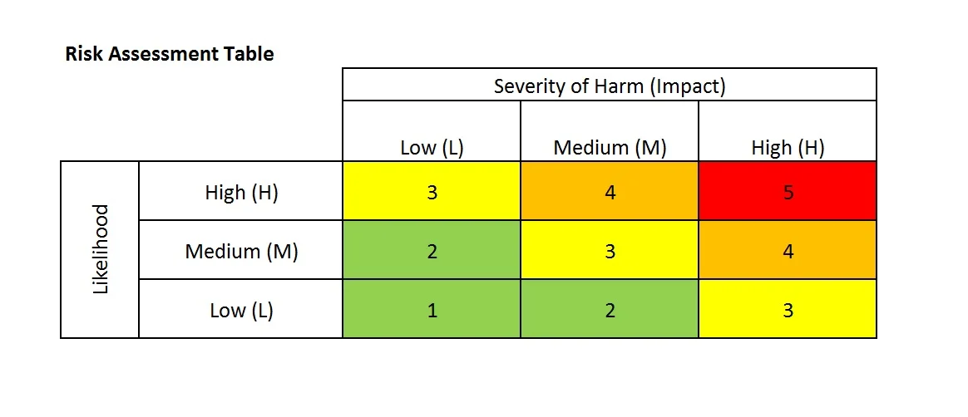
Hazard/risk | What might be harmed? | Severity of harm (impact)? | Likelihood of the hazard | Risk Rating | Risk Reduction
Weather conditions | The event will not take place due to bad weather. | H | L | 3 | Have a plan B indoors in case it rains.
Absence of responsible employees | Responsible employees may be on long-term sick leave. | M | M | 3 | Write weekly reports, work on given tasks in pairs.

Slide 27
Task 5 – Risk Analysis
Look at your SWOT analysis and define at least 3 hazards/risk
Make a Risk Rating and suggest measures to reduce the risk

Slide 28
Thank you for your attention!
Martin Cabrada
Czech University of Life Sciences Prague
cabrada@fld.czu.cz
+420 601 384 817

