Slide 1
Wild animals-based production
Ing. et Ing. Markéta Kalábová, Ph.D.

Slide 2
Content
Wild-animal product
Classification
Case study: Hunting tourism in the Czech Republic

Slide 3
Non-timber forest products management
Skins, hides or furskins can be defined as NWFPs when they originate from animals hunted in the wild
boundary between agricultural and forestry products
Notes:
This definition allows a boundary to be set between agricultural and forestry products, thus avoiding an overlap between categories in the classification systems.

Slide 4
Edible insects
Insects belong to the category of multipurpose non-wood forest products
increasing role in food security
FAO data state that species such as beetles, caterpillars, bees, wasps and ants are regularly consumed, as well as locusts, crickets, cicadas, leaf and plant hoppers, scale insects, true bugs, termites, dragonflies and flies
Central Product Classification are not explicitly classified - “Other meat” and are specified in the group of live animals
Notes:
Insects belong to the category of multipurpose non-wood forest products, as they are used in many products such as natural medicines, honey, cosmetics, silk, candles, and human and animal food.

Slide 5
Honey
Harvesting honey from the wild has been a longstanding activity passed on from one generation to another for many indigenous peoples.
living cultural tradition
consumed locally for health and food and traded
other products like beeswax, royal jelly and propolis
Notes:
Honey hunting is a living cultural tradition that is marked by traditional ecological practices and rituals which are still observed to this day.
Consumed locally for health and food, and traded as a source of livelihood, honey is essential to the lives of many.
Apart from honey, other products like beeswax, royal jelly and propolis are also utilized for consumption and trade.

Slide 6
Game-based products
“game meat”/“bushmeat” = meat of animals living in the wild
the collection of wild game has different meanings, mainly depending on the socioeconomic conditions of the area in which game is gathered
in developing economies, bushmeat represents an important source of forest income and plays an essential role in food security
in advanced economies, the collection of wild food is often considered a recreational activity and its value is mainly linked to its cultural benefits
great proportion of game is traded in informal marketing and is not captured by official statistics.
Notes:
In the context of non-wood forest products, the term “game meat” is often called “bushmeat” and is used to refer to the meat of animals living in the wild.
These can be mammals (from cats to gorillas), reptiles, amphibians and birds, and can vary by region.
In this context, the collection of wild game has different meanings, mainly depending on the socioeconomic conditions of the area in which game is gathered.

Slide 7
Existing classification
Central Product Classification (CPC) - meat and meat products constitute a section of food products structured in classes that can refer to meat processing and preservation
Edible meat and offal are defined at class level (four digits) according to the degree of processing and the kind of animal processed
The subclass level (five digits) refines the classes of animals by reference to species.
classes relate to mammals and poultry classified as fresh, frozen and prepared
“Other meat” comprises meat and offal of all other animals not categorized.
Notes:
Thus, categories of fresh or processed mammals, poultry and other kinds of meat exist.
The structure of the group is quite clear: classes relate to mammals and poultry classified as fresh, frozen and prepared; the same structure is used for edible offal; and, finally, a residual class of “Other meat” comprises meat and offal of all other animals not categorized.

Slide 8
Existing classification
game meat is scattered across several categories of meat products in the current international CPC and HS classification systems
Second, some subclasses/subheadings include meat from domestic animal species and wild animal species without differentiation.
Even when wild animal species are listed separately, they are not sufficiently detailed to separate wild animal meat hunted in the forest from the meat of farm animals
even when species of wild animals are listed within categories, it is still impossible to distinguish between agriculture and forestry products
Notes:
The current classifications exhibit several problems.
For example, wild boar and domestic pig meats are classified under the same subclass/subheading without further breakdown.
This makes it extremely difficult to estimate the production and trade volume of certain common game meat products.
Moreover, even when wild animal species are listed separately, they are not sufficiently detailed to separate wild animal meat hunted in the forest from the meat of farmreared animals. The same type of wild meat may be exclusively collected in the wild, farm-reared or both in a country.
Consequently, even when species of wild animals are listed within categories, it is still impossible to distinguish between agriculture and forestry products.
For greater clarity, the most relevant hunted species should also be listed at each subclass level.
With regard to the subclass of pig meat, the following should be mentioned:
Wild boar (Sus scrofa). - Warthogs (Phacochoerus aethiopicus), river hogs or pig deer (Potamochoerus porcus), and the black forest pig; babiroussa (Babyrousa babyrussa). - Peccary (wild swine) (Dicotyles tajacu).

Slide 9
Existing data
Data on meat production are usually provided by agricultural production statistics and refer to the activity of slaughterhouses.
updated forest product statistics on game meat are hard to find (self-consumption, illigal market)
In some countries statistics about hunted species
authorities responsible for wildlife monitoring could represent an additional data source
statistics from 17 EU countries - identified 97 species.
Cervus elaphus (red deer), Capreolus capreolus (roe deer), Lepus europaeus (hare), Phasianus colchicus (pheasant) and Sus scrofa (wild boar)
Further information could also be collected by food security agencies or by wildlife conservation institutions. For example, the Food Standards Agency of New Zealand and Australia provides data on wild game meat of kangaroos, wallabies, mutton birds and wild boars.
Notes:
The five main game species hunted in all countries include.
Further information could also be collected by food security agencies or by wildlife conservation institutions. For example, the Food Standards Agency of New Zealand and Australia provides data on wild game meat of kangaroos, wallabies, mutton birds and wild boars.

Slide 11
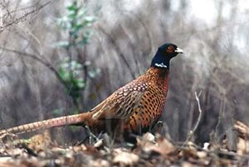
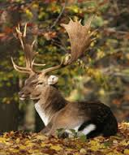
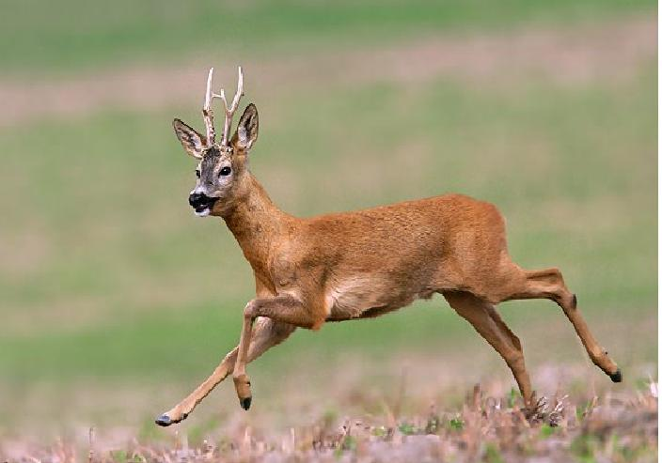
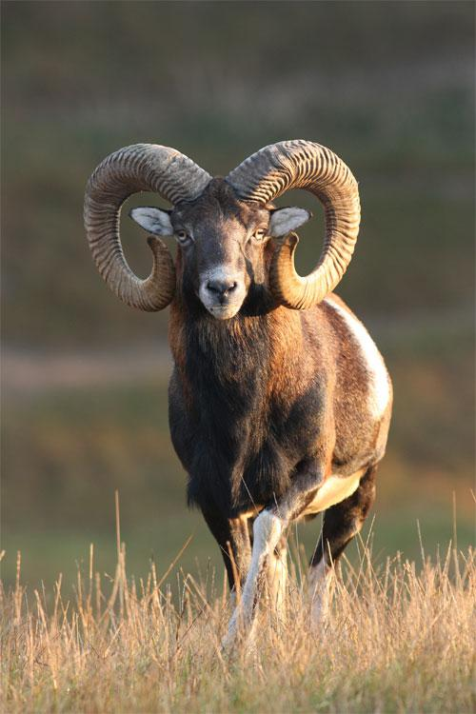
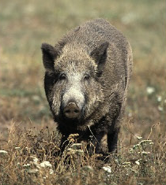
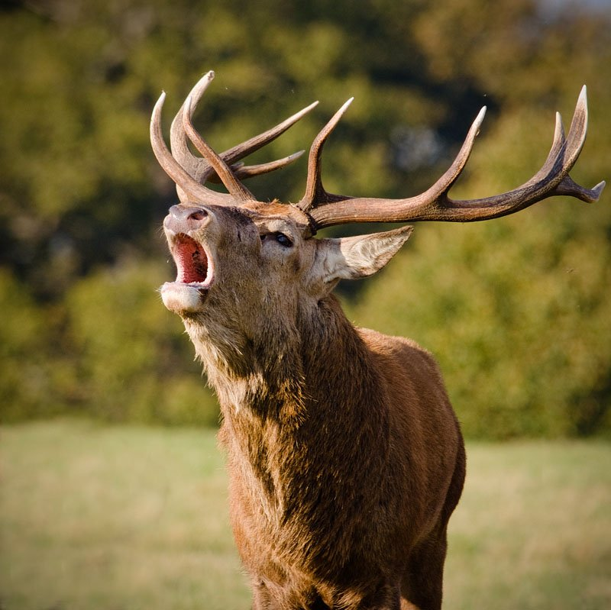
Hunting tourism in the Czech Republic

Slide 12
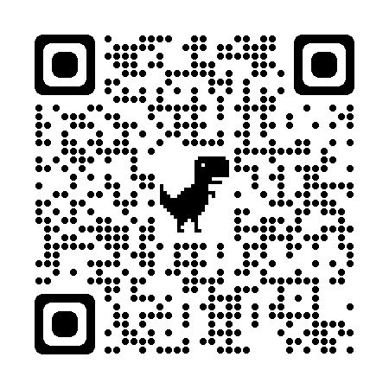
HUNTOUR
Development of education in relation to the influence of ongoing climate change to hunting tourism
ERASMUS+
2020 – 2023 (36 months)
Partnerhsip: Finland, Serbia, Hungary
Main outputs: educational materials
O1: multilanguage dictionary of hunting tourism terms
O2: Evaluation methods of economic impact of hunting tourism on economies
O3: Evaluation of hunting tourism potential in countries
O4: Sustainable hunting tourism in Europe

Slide 13
Economic impact of hunting tourism on Czechia
Foreign hunters:
In 2019, 10 634 foreign hunters visited the Czech Republic.
foreign hunters spend an average of EUR 1 776 per hunting stay.
Multiplier in hunting tourism (1,8) → EUR 34.7 million for the total direct and indirect impacts of hunting tourism on the Czech economy
Domestic hunters:
In 2019, 89 309 valid hunting licence holders were permanently exercising the right to hunt
24,4 % of Czech hunters participate in fee hunting
they spend an average EUR 1 181 on fee hunting and related services.
Multiplier in hunting tourism (1,8) → EUR 47.3 million for the total direct and indirect impacts of hunting tourism on the Czech economy.
In total, hunting tourism brings a value of EUR 82 million to the Czech economy (1,5 trillion Lao kip; 3 billion Thai baht)
Hunting tourist spent approximately 3.7 times more money than a regular tourist in the Czech Republic.

Slide 14
Hunting tourism
Domestic/foreign
Benefits: income to region, reduction of overpopulated wildlife, increase of job opportunities
Compliance with the conditions of sustainability
International Council for Game and Wildlife Conservation (CIC) - a form of sustainable hunting tourism is one of the tools of game protection

Slide 15
Specifics of hunting tourism
Limited by amount of game
Relatively high revenues can be generated by few clients
In some countries negative public opinion
High importance of sustainability
If it is sustainable it maintains and promotes biodiversity, if it is not, it is a violation of international conventions.
Annual hunting plan (number of growth)
Travelling with guns

Slide 16
Approaches of hunting in EU countries
Central European hunting system
(Belgium, Czech Republic, Austria, Luxembourg, Hungary, Germany, Netherlands, Poland, Slovakia and Slovenia)
Scandinavian Wildlife Management system
(Finland, Denmark, the Baltic States, Sweden)
Anglo-Saxon system of hunting
(Ireland, UK)
Latin system of hunting
(France, Italy, Cyprus, Malta, Portugal, Greece, Spain)

Slide 17
Advantages of hunting tourism
Conservation of ecosystems;
Substitution of potentially destructive land use with wildlife management as a form of environmentally friendly land use;
Income generation and employment in poor and disadvantaged areas;
Direct benefits for the rural population – monetary, nutrition, jobs;
Economic and wise use of habitats which are not well suited for agriculture and conventional tourism;
Ecosystem conservation through uses alternative to intensive agriculture;
Building awareness amongst the local population regarding the value of wildlife which is otherwise only regarded as harmful, a nuisance and a cost;
Less negative impacts on the environment in comparison with other forms of tourism;
Less poaching through the concerted efforts of all who are interested in the revenues generated by hunting tourism.

Slide 18
Hunt in the Czech republic
5 789 hunting clubs
6 873 096 ha - hunting area (88 %)

Slide 19
Key issues
The necessity of solving the problem of high population of game in the Czech Republic (extensive damages)
The growing trend of hunting tourism - within the Czech Republic and abroad
Evaluation of business opportunities
Inclusion of Czech hunting in the list of Intangible Cultural Heritage (2011) of the Czech Republic
Weak theoretical and analytical outputs in this area

Slide 20
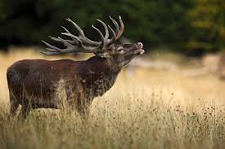
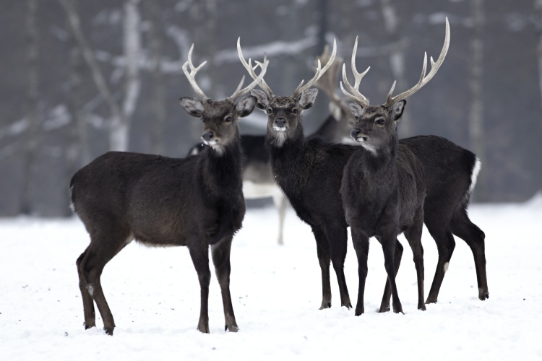
Product as main hunted species
Sika deer – in CZ 19.-20. century
Red deer
Source: KRNAP [cit. 2014-06-04]
Source: Tomi-art [cit. 2014-06-04]

Slide 21
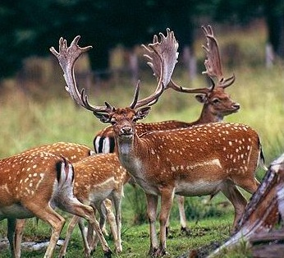
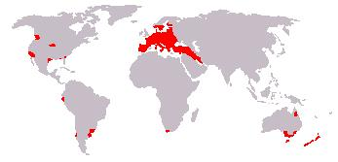
Product as main hunted species
Fallow deer – 16.century
Source: Myslivost [cit. 2014-06-04]

Slide 22
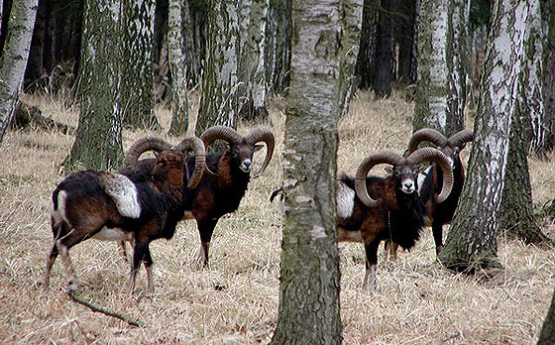
Product as main hunted species
Moufflon – 17. century
Source: Lesní správa Lány [cit. 2014-06-04]

Slide 23
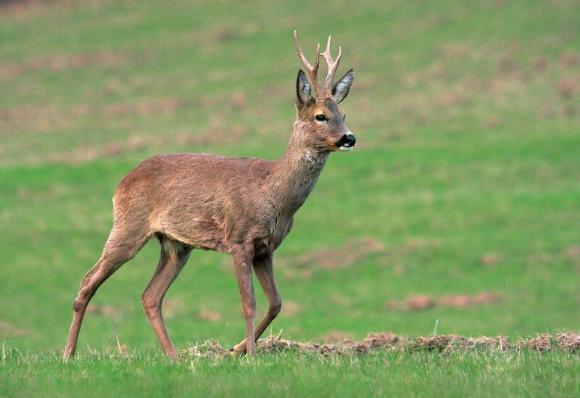
Product as main hunted species
Roe deer
Source: Myslivost [cit. 2014-06-04]

Slide 24
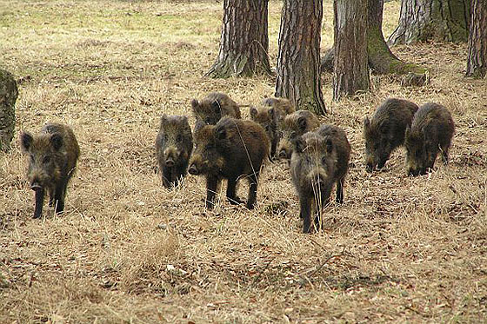
Product as main hunted species
Wild Boar
Source:
Lesní správa Lány [cit. 2014-06-04]

Slide 25
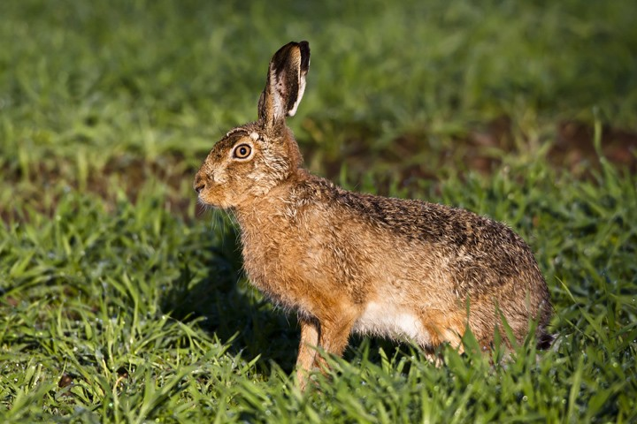
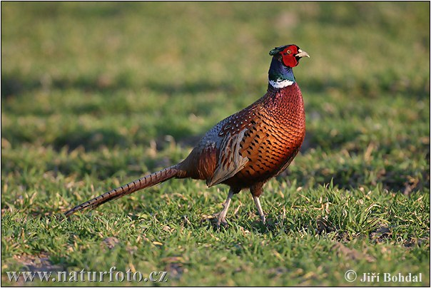
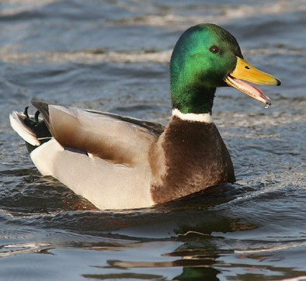

Slide 26
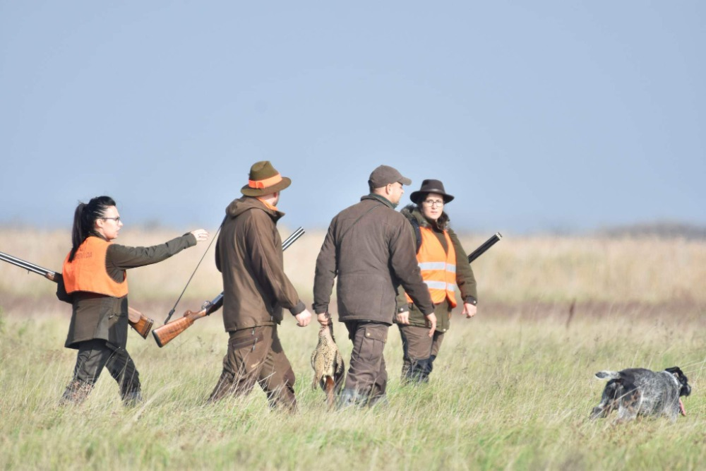
Driven hunts on hares and phaesants

Slide 27
Price – according to antlers

Slide 28
Foreign Hunters in the Czech Republic

Slide 29
Number of hunting licence

Slide 30
Hunters - nationality
Notes:
Austria, Germany, Slovakia, Switzerland, Netherlans, Italy, Denmark, others

Slide 31
Hunting licence – number of days

Slide 32
Main results
Sustainable hunting tourism is suitable tool for protection of wildlife.
Hunting tourism can help development of rural areas.
Numbers of most of hunted species in the CR are growing.
All regions have good potential for hunting tourism (except Prague)
Foreiners prefere hunt of females and cubs.
Czechs prefere hunt of red deer.
Czechs spend more money for hunt - because of trophy hunt

Slide 33
Resources and materials
Armenski, T. (2008): Strategy of hunting tourism development in Backa district. PMF, Novi Sad.
Baker, J. (1997): Trophy hunting as a sustainable use of wildlife resources in Southern and Eastern Africa. Journal of Sustainable Tourism, 5, 4, 306–321.
Bauer, J., Herr, A. (2004): Hunting and fishing tourism, In: Higgenbottom, K. (ed): Wildlife Tourism: Impacts, Management and Planning: CRC for Sustainable Tourism. Common Ground Publishing, Brisbane, 57–75.
Brainerd, S. (2007): Convention on the Conservation of European Wildlife Natural Habitats: European Charter on Hunting and Biodiversity. Norwegian Association of Hunters & Anglers, Oslo.
Higginbottom, K., TRIBE, A. (2004): Contributions of wildlife tourism to conservation. In: Higginbottom, K. (ed.): Wildlife tourism: impact, management and planning. Common Ground Publishing. Altona, Australia, 99–123.
Lindsey, P. A., Alexander, R., Frank, L. G., Mathieson, A., Romanach, S. S. (2006): Potential of trophy hunting to create incentives for wildlife conservation in Africa where alternative wildlife-based land uses may not be viable. Animal Conservation, 9, 283–291.
Lovelock, B. (2008): Tourism and the Consumption of Wildlife: Hunting, Shooting and Sport Fishing. Routledge, New York.
Marković, V., Vasiljević, Dj., Jovanović, T., Lukić, T., Vujičić, M., Kovačević, M., Ristić, Z., Marković, S., Ristanović, B., Sakulski, D. (2017): The effect of natural and human-induced habitat conditions on number of roe deer: case stuty of Vojvodina, Serbia. Acta geographica Slovenica, 57, 2, 58–69.
Matejević, M. (2017): Canine events as a segment of tourism offer. Turizam, 21, 3, 132–138.
Willebrand, T (2009): Promoting hunting tourism in north Sweden: opinions of local hunters. European Journal of Wildlife Research, 55, 209–216.
https://unstats.un.org/unsd/classifications/expertgroup/egm2017/ac340-Bk3.PDF

Slide 34
Group discussion
What are the main wild animals in your country? Is it possible to hunt/under which conditions? Is it possible for foreign hunters to come to your country for a hunt?
What is public opinion on hunting/hunting tourism? What is your opinion? Would you be able to hunt something?
Do you think there is a potential for the development of hunting tourism?

Slide 35
Thank you for your attention
kalabova@fld.czu.cz

